Slide 1
2023 Childhood Ministry Training
Texas Baptists

Slide 2
Notes:
Introduction (Slide #2)
Introduce yourself here. Tell what position you serve in at your church, how long you have been in ministry, your education and your family. Tell a personal story about the first time you served in children’s ministry as a volunteer. Reflect back on how you felt called to serve and how you learned to teach children. Be honest about your learning curve and try to relate to your group on a personal level.
Here is the story I share:
I remember what it was like teaching my first class before I ever served on church staff. I remember being a college student with a room full of 5th graders, ready to learn, but a teacher who was not sure where to start. And I was a relatively new Christian too. I was basically learning alongside my students. Maybe you are feeling the same way? Not to worry, I am here to help. If I can learn, I know you can.
In our session today, my goal is to give you some tools that I learned along the way to help you be as successful in your class as possible.

Slide 3
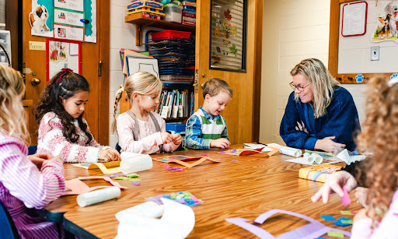
What is your role as a teacher?
You are more than a conduit of information.
Teachers lead through example and relationship.
Notes:
What is your role as a teacher? (Slide #3)
(press space bar) You are more than just a conduit of information. You are teaching from the most important textbook, the Bible. Yes, you have content to share. But this content is more than just information sharing, it speaks into a child’s spiritual walk and helps transform their lives. We do not teach for mere content, but for transformation. The way in which we speak these truths will communicate to a child the importance of the message. We are not just transferring information, but also discipling children in the faith.
(press space bar) Teachers lead through example and relationships. Children learn through relationships, not just with their peers, but also with their teachers and families.
Our goal is to teach for transformation, to disciple others, and to help them in their journey to be more like Christ.
Consider Luke 6:40 “A disciple is not above his teacher, but everyone when he is fully trained will be like his teacher.”

Slide 4
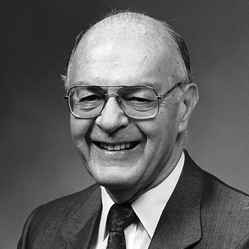
Howard Hendricks
“You teach what you know but you reproduce what you are.”
“The effective teacher always teaches from the overflow of a full life…”
Notes:
(Slide #4) Howard Hendricks, longtime professor at Dallas Theological Seminary, once said, “You teach what you know, but you reproduce what you are.” In other words, are we living out our faith in such a way that the children we serve can’t help but imitate us?
It is Christ doing the work in the child. We are merely a vessel, the hands and feet.
Hendricks also said, “The effective teacher always teaches from the overflow of a full life…” We cannot teach what we don’t already possess or know ourselves. We must be pouring into our own lives too through prayer, Scripture reading and personal Bible study. Think of ways in which you regularly allow God to speak to you through Scripture, prayer or your quiet time.

Slide 5
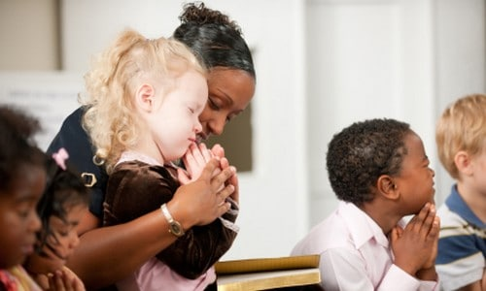
Teaching is an investment in the lives we serve.
We must be available and approachable.
Be a student of your students.
Notes:
(Slide #5) Teaching is an investment in the lives that we serve.
(press space bar) We must be both available and approachable.
How can you do this? Listen to the stories that the children tell you. They will take the initiative. Listen and respond. Get down to their level and speak eye-to-eye.
Let them know that what they say matters. I’ve heard it said that “People will not care what you know until they know how much you care.” Children are the same too.
Spend time getting to know the children that God has entrusted in your care. What are some ways you can get to know these children? Ask questions, invest in their lives, celebrate with them when good things happen, see them as individuals and not just a group or class.
(press space bar) Be a student of your students.
Know your students and what their individual needs are. Are they shy and afraid to volunteer answers? Do they like to be first in line? Are they competitive? Do they ask lots of questions? Each child is different, and each group (from year to year) is different too.
Be familiar with the group dynamics and understand what works. This may take some time, but be patient with the process.

Slide 6
4 Practices of Interpretation
Personal Preparation
Assumptions
Background of the Book
“Fourfold Approach” to the Text
Notes:
(Slide #6) Jim Denison, in A Light Unto My Path, outlines some practical help to guide us in reading and interpreting the Bible with greater clarity and integrity. The following ideas come from Chapter 7 of this book, and you will get a copy of this book as you leave today.
Personal Preparation (commitments we need to make)
Have a personal relationship with God
Commit to hard work
Commit to obey what you discover (“Before you open God’s word, you must first open your heart to its truth.” Denison, p. 167)
Assumptions/Presuppositions
Scripture CAN be understood
“We will seek to learn from the study of others, but we will not begin there. We will start with the text itself.” (Denison, p. 168)
The NT interprets the OT
Scripture interprets scripture
“Because God’s word is unified, coherent, and fully inspired, the best way to understand any single passage is to interpret that text in light of the entire Scripture” (Denison, p. 170)
Accountability of the teacher (Jas. 3:1)
Background of the Whole Book
Author, recipients, author’s purpose, kind of literature, culture
“Before we can study any particular verse in the Bible, we should first examine the book in which it is found.” (Denison, p. 173)
“Fourfold Approach” to a Specific Text
Read 3X in diff translations
Who, what, when, where, why
Grammar (words, sentences)
History (geog., hist. context)
Theology (central ideas/truths)
Practical (application today)
Does your curriculum help you with these practices?
Resources to help…txb.org/dc

Slide 7
Piaget’s Stages of Cognitive Development
Birth-2 years
Sensorimotor
Experiences the world through the senses
Object Permanence
2-6 years
Preoperational
Imagination/Dramatic Play, Egocentric
Objects are symbols, language is being developed.
7-11 years
Concrete
Operational
Logical thinking, concrete reasoning.
Conservation
Ethics, Moral Development
12 years to adulthood
Formal Operational
Abstract thinking, can manipulate ideas in their minds.
Notes:
Section #2:
Now that we have discussed the role of the teacher, let’s discuss the children and the different developmental stages of growth.
Today we will focus on the cognitive levels of development, as developed by Jean Piaget (pee uh zhay), who was a Swiss psychologist. Piaget was known for his work on child development and developed a theory of cognitive development that defined how children develop intellectually throughout the course of childhood.
(Slide #7)
Birth - 2 years: Sensorimotor State: At this stage of development, babies and toddlers experience the world through their senses. They explore their curiosity by looking, touching and mouthing. This is why little ones always put things in their mouth...this is how they discover the world. At this stage babies do not have a sense of object permanence. In other words, when something is out of sight, it no longer exists. As a child develops, they learn that things can still exist even when we don’t see them. They also have stranger anxiety at this stage. This is why younger children will cry when mom and dad leave them in the nursery.
2-6 years: Preoperational: At this phase, language is being developed and objects can be represented by words, but they have yet to think logically. They can attach words to symbols, using language. They can string words together to form sentences, but are not yet able to think logically. For instance, they can count to 10, but are not able to add or subtract yet. At this stage, children also engage in pretend play. For instance, they can pretend that a broom is a horse and pretend to be a cowboy.
They are egocentric, which is the inability to differentiate themselves from others. They are unable to see the world from another person’s perspective. Usually this egocentrism subsides by age 7. So, for instance, since it’s all about me, children will complain about things being “fair” or others not “sharing”. They are concerned about “me” at this stage.
At the early stages, around 2-3, children prefer to play alongside their peers, but as they age, they start playing with their peers.
7-11 years: Concrete Operational State: Children are now able to think logically. “Conservation” is a child’s ability to see that even though something changes form the quantity stays the same. For instance, if I have a glass of water, and I pour the liquid into two cups, I still have the same amount of water. Children can sort out that logic. Demonstrate with two glasses of water. They think in terms of concrete reasoning. This means that they are literal thinkers that focus on the physical. They take things at face value. So, when we discuss Jesus dying on the cross for our sins, they can internalize this story and understand its value, however, the concept of “grace” is still too abstract for them to fully comprehend.
Age 12 years - adulthood: Formal Operational State: Around the age of 12, children can now think in abstract terms. This means that they can manipulate ideas in their head, without having to manipulate things in their hands. They can understand concepts like “grace”, which was difficult for them to process before. Their moral development is also complete by around 9-12 years of age. This means that they can reason through more than just good and bad, but also right and wrong.
Knowing these stages of development can be helpful when we teach. We cannot teach a 5th grader in the same way we do for a 2 year old. There are age appropriate levels of learning that can guide us.

Slide 8
www.lifeway.com/en/special-emphasis/levels-of-biblical-learning
Notes:
(Slide #8) Lifeway has published the “Levels of Biblical Learning” to help guide us in this process. You can find a full explanation of these Levels of Biblical Learning on this website: (press space bar) www.lifeway.com/en/special-emphasis/levels-of-biblical-learning.

Slide 9
Dr. Seuss
“Today you are YOU, that is truer than true. There is NO ONE alive that is YOUER than YOU!”
Notes:
Section #3
Incorporating Learning Styles into Your Teaching
(Slide #9) Dr. Seuss says, “Today you are you. That is truer than true. There is no one alive that is youer than you.”
This is so true. Each child, each individual is different, and we learn differently. We have different learning styles that you must keep in mind when teaching. Let’s take a moment and look at those learning styles.

Slide 10
Learning Styles
Verbal
Visual
Physical
Musical
Which learning style are you?
Logical
Relational
Reflective
Natural
Notes:
(Slide #10):
(press space bar) VERBAL: Your verbal learner thrives on words, spoken or heard. They will benefit from reading Scripture, reciting scripts or talking.
(press space bar) VISUAL: Your visual learner needs to “see” things. Your verbal learner will be strong in the subjects of English and History. In conversation, your visual learner will often reference things they have read. Charts and graphs are helpful to a visual learner. In the church, using teaching pictures appeals to this learning style. Also showing objects in an object lesson. For instance, the visual that I used with the water and the glasses would have appealed to a visual learner.
(press space bar) PHYSICAL: A physical or kinesthetic learner needs to touch or manipulate things in order to learn. This is also your tactile learner, which appeals to the sense of touch. They like to work with their hands and prefer concrete activities. They will need to practice a new skill instead of just reading about it. So, having an activity that the children can physically do appeals to your kinesthetic learner.
(press space bar) MUSICAL - A musical learner learns through sounds or rhythms. They love to sing or play musical instruments. Singing the “Books of the Bible” song is an example of learning through music.
(press space bar) LOGICAL - A logical learner learns through systems and sequences, trying to figure things out logically. These children are usually strong in math or science. You can have children solve puzzles or piece things together, anything that requires logic and reasoning.
(press space bar) RELATIONAL - Your relational learner learns best when he/she is around others. They love working in groups. An example of this would be an activity game where all the children participate.
(press space bar) REFLECTIVE - This learner prefers to work alone in solidarity. They enjoy writing down their thoughts and thinking through their feelings.
(press space bar) NATURAL - Your natural learner learns best by being in nature. Children need more outdoor play, so taking time to go outside on a nature walk, or just sitting under a tree while you do your Bible study is an example of the natural learning style.
Invite the group to take the learning styles questionnaire, note their strengths and weaknesses. If you have a dry erase board, write the names of each person, with their strengths and weaknesses. Share your learning styles too. We tend to teach from our personal learning styles. Have the class consider how they might appeal to a learning style that is not within their strengths.

Slide 11
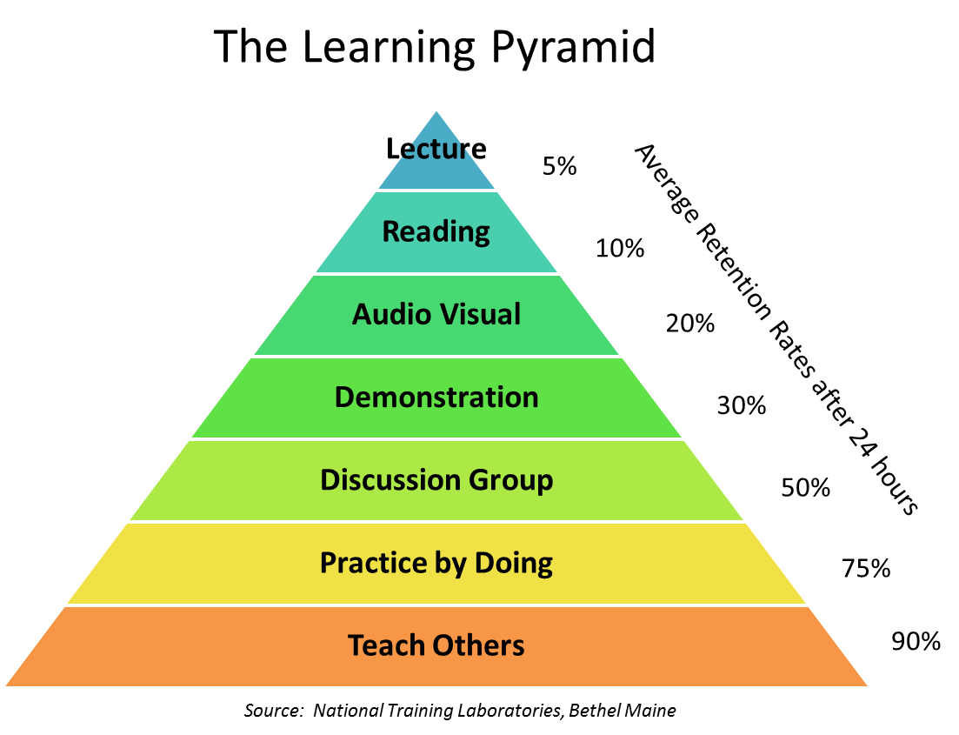
Notes:
(Slide #11) Before we move on, let’s take a look at the Levels of Learning Pyramid. This chart does a good job in demonstrating the various ways in which we teach (lecture, reading, audio/visual, demonstration, discussion groups, practice by doing and teaching others). However, it also shows the retention rate attached to each teaching style. For instance, we only retain 5% of what we hear by lecture alone. Our retention increases the more we become involved in the learning process. So, for the audio/visual, you would retain about 20% of what you see and hear. I’ve tried to incorporate this within our session today by (visual Powerpoint, discussion times with our learning styles, collaborating with each other, etc) . Notice how we learn best...by teaching others (90%). How might we incorporate this within our Sunday school lessons? Pair up with a partner and discuss.

Slide 12
2023 Childhood Ministry Training
Texas Baptists
Notes:
My prayer for you, as a new teacher, is that you will experience joy in your ministry. God has given you this precious group to pour into and to make disciples of Christ. There is no greater calling than that.
Close with a word of prayer. Let your class know that you are here to help and assist. If they have further questions or need assistance they can contact you or Texas Baptists.
Please feel free to share my contact information:
Jennifer Howington, Childhood Ministry Specialist
jennifer.howington@txb.org.

