Slide 1


Slide 2


Notes:
Introduction (Slide #2)
Introduce yourself here. Tell what position you serve in at your church, how long you have been in ministry, your education and your family. Tell a personal story about the first time you served in children’s ministry as a volunteer. Reflect back on how you felt called to serve and how you learned to teach children. Be honest about your learning curve and try to relate to your group on a personal level.
Here is the story I share:
I remember what it was like teaching my first class before I ever served on church staff. I remember being a college student with a room full of 5th graders, ready to learn, but a teacher who was not sure where to start. And I was a relatively new Christian too. I was basically learning alongside my students. Maybe you are feeling the same way? Not to worry, I am here to help. If I can learn, I know you can.
In our session today, my goal is to give you some tools that I learned along the way to help you be as successful in your class as possible.

Slide 3
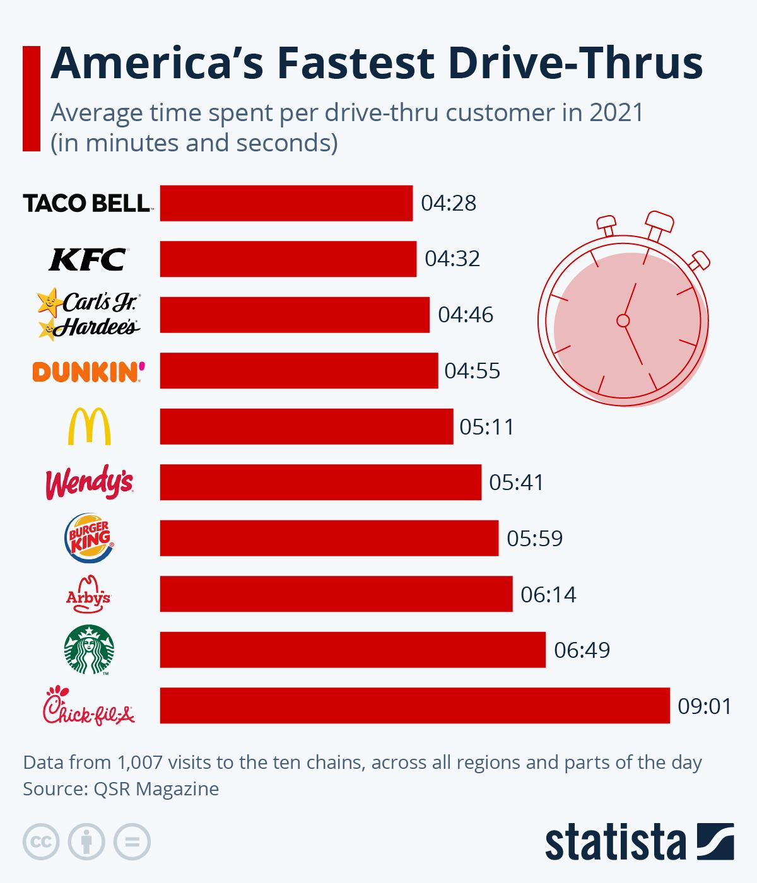
Notes:
Icebreaker (Slide #3) (If time permits.)
We live in an “instant society”. Everyone wants things immediately and without hesitation. Can you name a few things that we want instantly and conveniently? (ie, curbside grocery service, instant access to the internet, Door Dash, fast food, etc.).
Consider our eating and the fast food industry. This week I read a survey from 2021 that detailed which fast food chain restaurant was the fastest. Any guesses?
#1 Taco Bell – 4:28 minutes
#2 KFC – 4:32 minutes
#3 Carl’s Jr. – 4:46 minutes
#4 Dunkin’ Donuts – 4:55 minutes
Surprisingly Chick-fil-A was ranked #10th at 9:01 minutes. I would have thought they were first. They always seem so efficient with their drive thru lines, and always have such a pleasant “My Pleasure” response.
The truth is, we live in an instant society. We want things, and we want it now!
So, what’s the hurry? Do you find yourself in a hurry sometimes? All the time? It seems the more I get done, the more I need to do.
There are just some things we cannot rush. The truth is we cannot rush the conversion process of a child or even an adult for that matter.

Slide 4
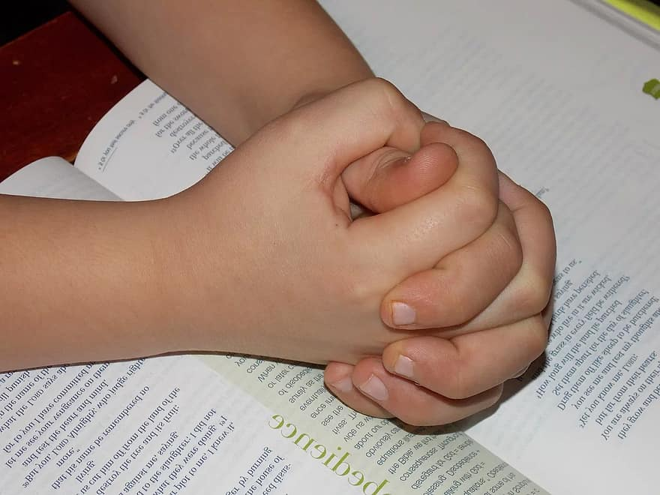
Faith Formation in Children

Slide 5

Without speaking to one another, organize yourselves in a line in the order of the age you prayed to receive Christ as your Lord and Savior.
Notes:
Interactive Activity (Slide #5)
Challenge the group to organize themselves in a line across the room. The goal is to put themselves in the order of the age in which they prayed to receive Christ as their Lord and Savior. They are not to speak to one another, but can use hand motions or gestures.

Slide 6
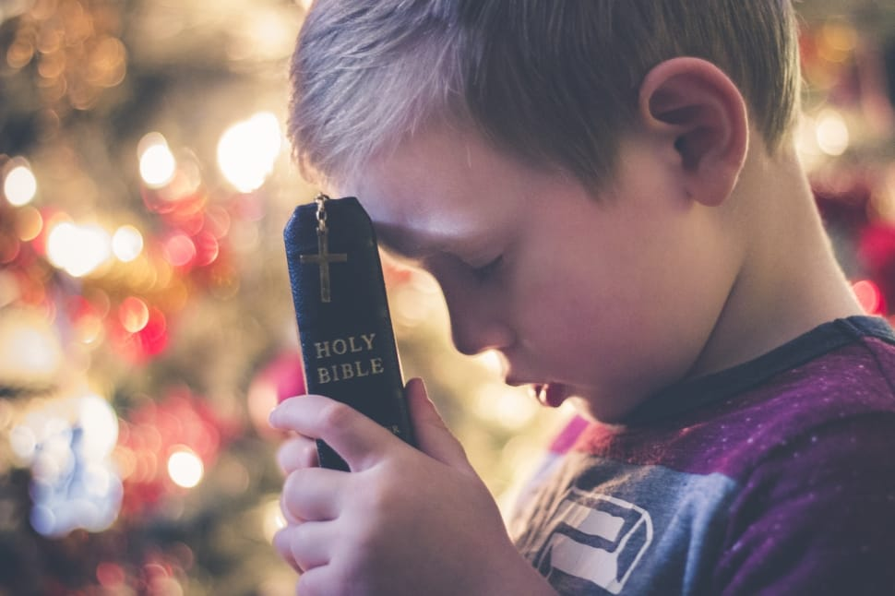
More than 50% of people who believe in Christ will do so by the age of 13.
The probability of a person accepting Christ in adulthood is 6%.
The role of children’s ministry is imperative during the formative years of life.
Notes:
Statistics on Conversion (Slide #6)
According to Steve Parr & Tom Crites, in Why They Stay, more than 50% of people who make a profession to follow Christ, will do so by the age of 13. Did we find this statistic to be true in our earlier activity?
Parr & Crites also state that the probability of a person accepting Christ in adulthood is 6%.
If these statistics are true, then the role of children’s ministry is imperative during the formative years.
In today’s culture, parents have abdicated their role as spiritual leaders of the home and given it to the church. The church was never meant to do this alone.
According to research, the #1 reason a young adult would stay in church is “family upbringing” (Why They Stay, 55).

Slide 7

Consider a Plant:
It Takes Time
Notes:
Plant Illustration (Slide #7)
Consider a plant. (If you have one as a prop you can bring, use that in this illustration.)
How many of you like to garden or grow plants? Maybe you have a flower or vegetable garden? What do you notice about growing plants? It takes time to grow.
It took time to plant the seeds, to water the soil, to till the soil, and then to harvest the fruit The same is true with the process of leading a child to Christ. It takes time and intentionality.
According to Barna research, a child’s moral development is complete by age 9. Children can understand more than we think they can. The process of conversion is different for everyone, and is something we should never rush a child into.
The important thing we can do is to develop a trust relationship with these children. It would be very difficult for a child to believe in and trust a God (whom he cannot see) if he can’t trust the significant adults in his life (that he can see)!

Slide 8



Admit that you are a sinner
Believe that Jesus is God’s Son
Confess Jesus as Your Lord and Savior
Notes:
ABC’s of Becoming a Christian (Slide #8)
A – Admit that you are a sinner.
B – Believe that Jesus is God’s Son
C – Confess Jesus as your Lord and Savior.

Slide 9




Decide
Every day
to
Follow
God
Notes:
DEFG of Discipleship (Slide #9)
We could also expand this to include discipleship once someone becomes a follower of Christ.
D.E.F.G.
Decide
Everyday to
Follow
God

Slide 10
What Does the Bible Say about Children and Salvation?
II Samuel 12:22-23
I Samuel 3:7
Matthew 18:14
Matthew 19:14
Notes:
Scripture Verses (Slide #10)
Can you think of a specific story in the Bible related to children and salvation? (Allow for responses.)
What does the Bible say about leading children to Christ?
II Samuel 12:22-23: David’s infant child. “I will go to him, but he will not return to me.”
I Samuel 3:7: Samuel did not yet know the Lord, meaning that there was a point in time when God’s Word would be revealed to him.
Matthew 18:14: God does not want any of the little ones to perish.
Matthew 19:14: “Let the children come to me and do not hinder them…” Jesus placed a high priority on children.
Don’t you love that? He could have definitely been a Children’s Pastor!!
We need to be committed and ready to share the Gospel with children at any time. In fact, we are building a foundation of faith that they will carry for a lifetime.

Slide 11
Spiritual Characteristics of Preschoolers & Children
Kids Ministry 101: Practical Answers to Questions About Kids Ministry CD-ROM Item 32, Characteristics of Preschoolers and Children © 2009, LifeWay Press®.
Notes:
Spiritual Characteristics of Preschoolers & Children by Lifeway (Slide #11)

Slide 12
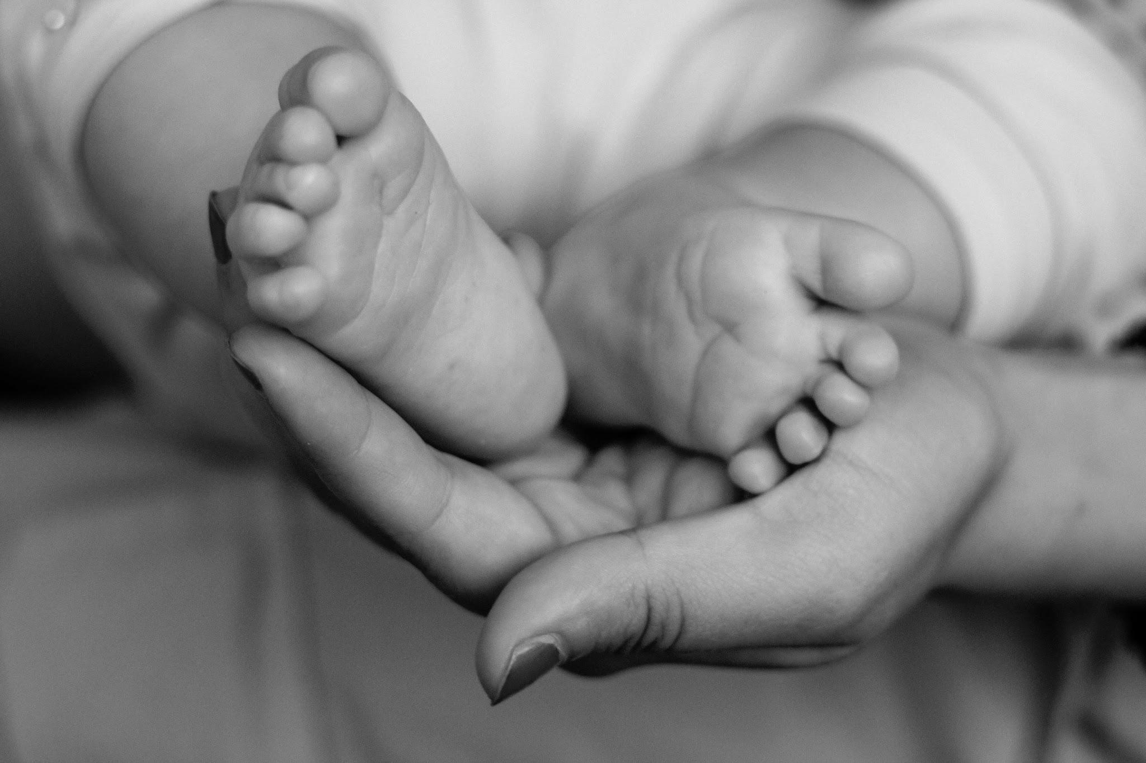
Infants/Babies
Develop a sense of trust as needs are met consistently.
Sense attitudes and expressions of love.
Learn to associate God’s name with love and trust.
Sense importance associated with Jesus and the Bible.
May point to the Bible and pictures of Jesus.
Notes:
Infants/Babies (Slide #12)
God’s design for spiritual growth begins at birth (Deut. 6:4-7).
We must start building a foundation of faith from infancy.
We are more than babysitters, we are building a faith foundation from the time a child is born.
Babies must first develop a sense of trust in those that provide care. The tenderness we show when we rock them, when we care for their needs, and when we respond to their cries, all communicate God’s love.
We need to be speaking God’s name, singing worship songs, and telling babies that God loves them.

Slide 13
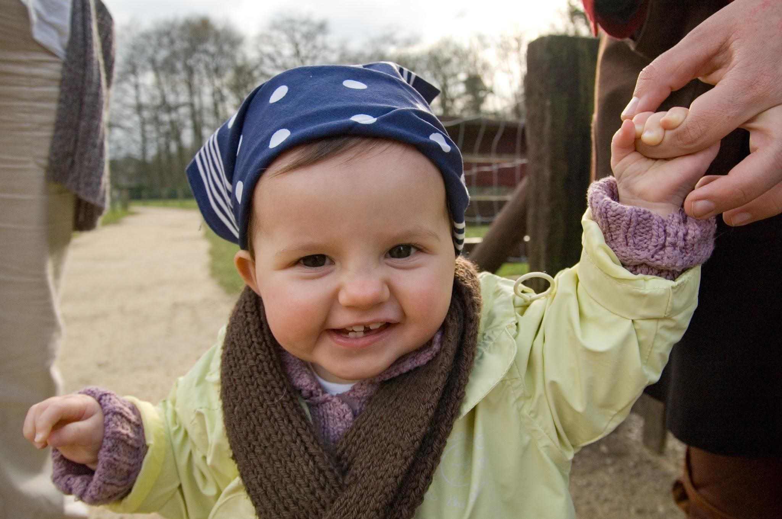
One Year Olds
Begin to make simple choices.
Continue to grow in trust of adults.
Trusting the adults they can see helps a child develop trust for a God they cannot see.
According to Barna Research, a child begins to develop his/her worldview at 15 months.
Begin to distinguish between acceptable & unacceptable behavior.
Notes:
One Year Olds (Slide #13)
Building trust is key at this age. How can a child learn to trust in a God they cannot see, if they can’t trust the adults they can see?
According to Barna Research, a child begins to develop his/her worldview at age 15 months, and completes this by age 13!!
Begin to learn that Jesus is my friend, that the Bible is a special book, and that God made people and everything in the world.

Slide 14
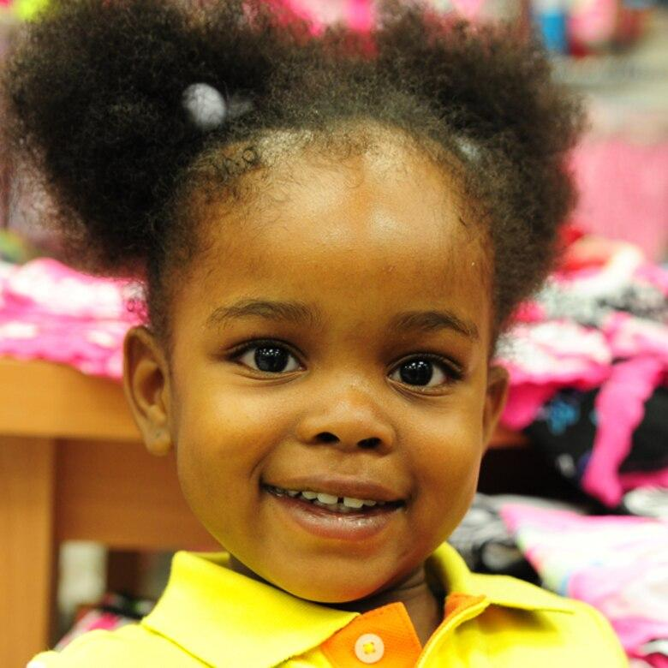
Two & Three Year Olds
Can sing simple songs about God and Jesus.
Can say thank you to God.
Can listen to Bible stories.
Notes:
Two & Three Year Olds (Slide #13)
Language is being developed and children can sing and recite simple verses.
Children can say simple prayers and understand that God hears their prayers.
Children at this age are egocentric, but they are beginning to learn about good and bad.
Understand that Jesus loves them and is their friend.
It’s important to emphasize that stories in the Bible are true and that the Bible is a special book from God.
Make sure to always have the Bible with you when you teach Bible lessons. Even though children at this age cannot read, they can begin associating the Bible stories with God’s Word.

Slide 15
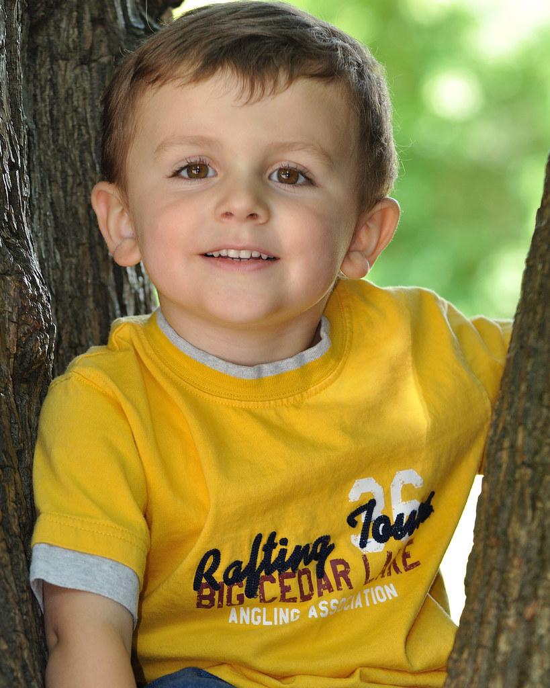
Four Year Olds
Like to retell Bible stories.
Enjoy Bible verse games.
Recognize that God and Jesus love people and help people in special ways.
Accept responsibility for helping people.
Exhibit a conscience.
Notes:
Four Year Olds (Slide #14)
Begin to understand more about Jesus. That He loves them, that He was a real person, and that He did miracles and helped people.
Children at this age can understand that they are part of the church and can be helpers.
Children love repetition at this age and feel a sense of mastery when they can recite a verse or sing a Bible song.

Slide 16
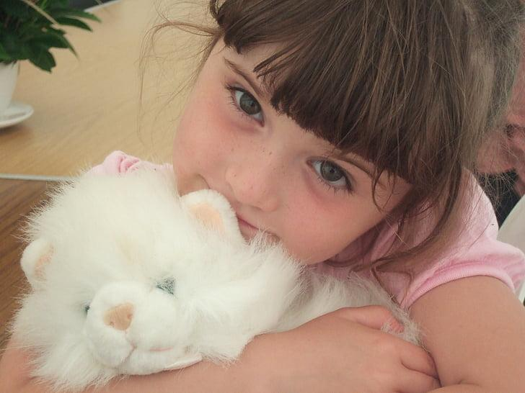
Pre-Kindergarten
Begin to ask questions about God.
Express love for God & Jesus
Can recall simple Bible stories
Can make life application of Bible verses
May show concern for others
Continue to develop a conscience
Notes:
Pre-Kindergarten (Slide #16)
Children are naturally relational learners. They learn through relationships with the people they trust.
Children love to learn through play. Make teaching as interactive as possible with multiple activities and opportunities for learning.

Slide 17

Kindergarteners
Remember & like to tell Bible stories
Use the Bible & like to find Bible verses
Like to know they are doing what the Bible says
Try to help & love others
Like to take care of the world
Express guilt for misbehavior
Notes:
Kindergarteners (Slide #17)
Children at this age are beginning to enter school and are able to do things more independently.
Relationships are still very important and want to feel loved and accepted by the adults in their lives.

Slide 18
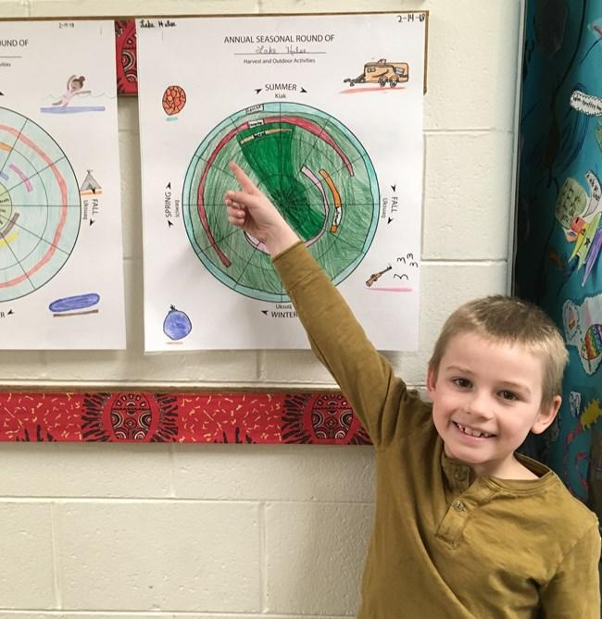
1st & 2nd Graders
Are interested in God’s wonders in nature
Are making conclusions about God & regard Jesus as a friend
Are learning right from wrong
Can take some responsibility for own actions
Understand truth & honesty
Notes:
1st & 2nd Graders (Slide #18)
Children begin to learn more about Jesus, how he lived on earth, died on the cross and rose from the dead.
The Holy Spirit is introduced as a helper. This is still an abstract concept that a child cannot fully understand until they are older.
Children are learning deeper truths about salvation.
They often develop an understanding of sin before they realize their need for a Savior.

Slide 19
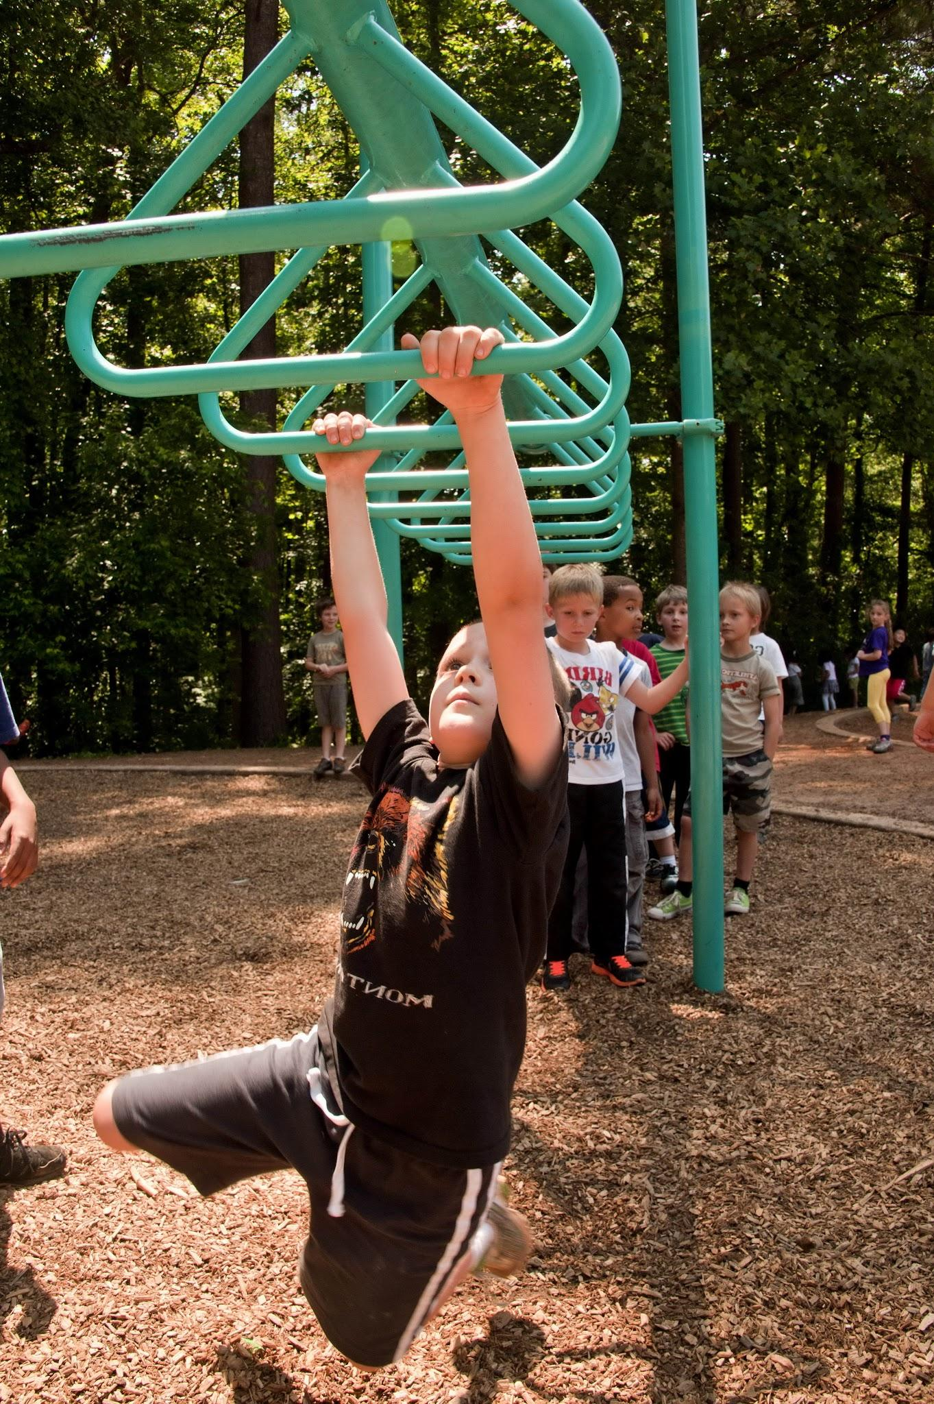
3rd & 4th Graders
Ask serious questions about religion
Are often beginning to feel the need for a Savior
Are growing conscious of self and of sin
Want to do things the right way & may feel ashamed when wrong
Think in terms of right & wrong more than good & evil
Notes:
3rd & 4th Graders (Slide #19)
Become more aware of their sinful nature.
Often begin to feel the need for a Savior.
Understand more clearly Jesus’ sacrifice on the cross and God’s plan for our salvation.

Slide 20
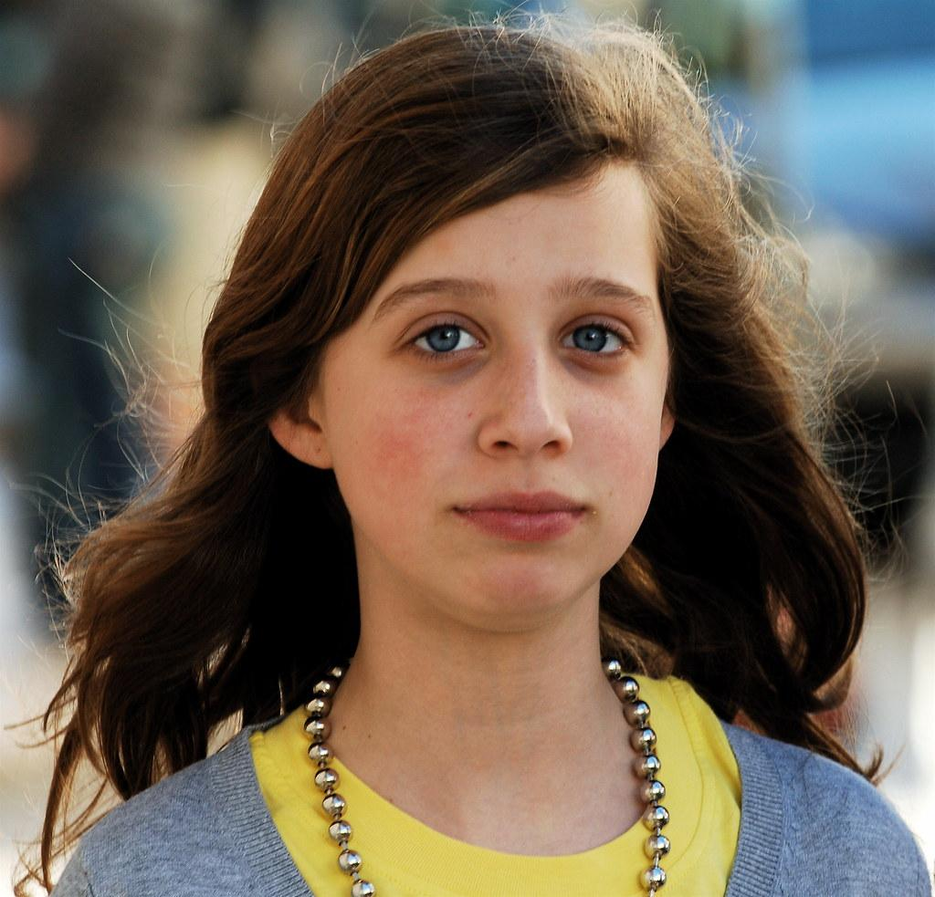
Preteens
Have formed concepts of personal worth
Feel deeply about own experiences; can be sensitive to others
According to Barna Research, an individual's worldview will be completed by age 13
Can make many choices, but may not follow through on long-term commitments
Notes:
Preteens (Slide #20)
A child’s worldview is complete by age 13. Their moral development is complete by age 9.
Preteens are interested in the “why” instead of the “what” of religious beliefs. Why is this important for my life?
Preteens are ready to go deeper and ask questions about faith so they can make faith their own.

Slide 21
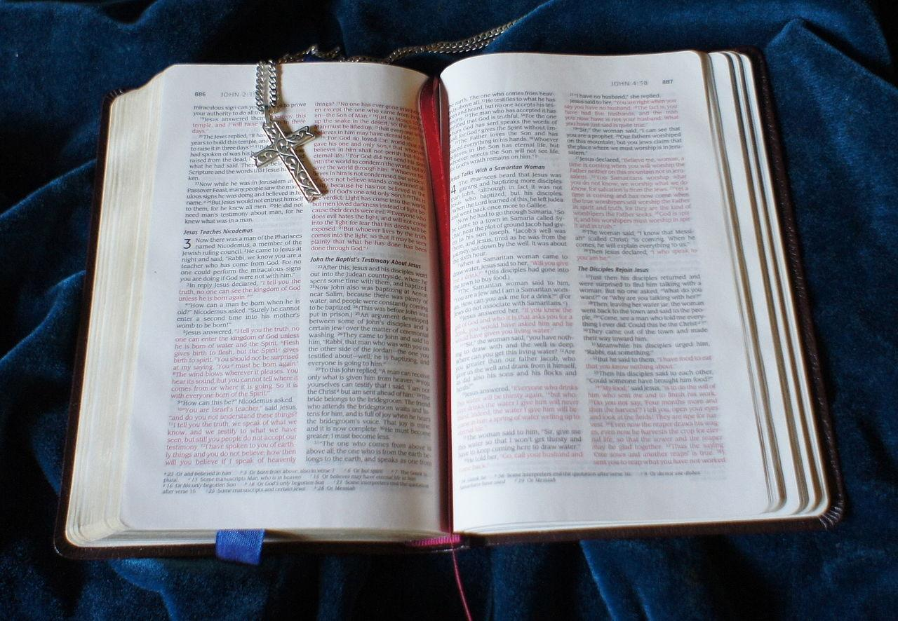
The Gospel Message is the same for children as it is for adults.
Notes:
Although children learn about God in age appropriate ways, the gospel message is the same for children as it is for adults.
There is no “junior” gospel message.

Slide 22

Children learn about God in stages
Notes:
Children Learn About God in Stages (Slide #22)
“Salvation is the work of the Holy Spirit. Our role as God’s nurturers in this holy work is to prepare the way by teaching, modeling, guiding, and encouraging children in our care” (Haywood, p. 50).
This is a process of learning the “bits & pieces” that later develop into a “decision”.
Children first learn about Jesus as their friend in preschool, and then they grow into their understanding of Jesus as their Savior. What elements about Jesus do they need to know?
Who is Jesus?
He wasn’t just a good man or a prophet. He IS God!
What did Jesus do? Most will say he died on the cross. That’s not the end of the story. He also rose from the grave and defeated death. Why did Jesus come to earth?
It’s important that children understand that the Jesus who was born in the manger was the same Jesus that grew up and died on the cross.
Here is a story I share about my own child:
When my son, Kaden, was little, he asked me when God was born. I said that God was never “born” and that He has always existed. God has no beginning or end. He then said, “Well then what about when He died on the cross?” To him, “dying” was an ending. I had to explain that that wasn’t the end for Jesus and that He rose again and now lives in Heaven. Very interesting comment from a 6-year old. He was getting the “bits and pieces” of his faith.
What is sin?
Children can often identify what sin is (hitting their sister, disobeying their parents, etc); however, they have to grow in their understanding that they are a sinner in need of a Savior. This is the work of the Holy Spirit in their lives as they fall under conviction.
Why should I become a Christian? The Bible teaches us that God’s desire is for us all to know Him personally.
How can I accept Jesus as my Savior? Once you are comfortable that the child understands, then it is appropriate to lead them in the prayer. Be careful to allow room for the Holy Spirit to work in their lives and not feel pressured to make a decision.
Be careful and wise with their understanding! It is possible for a child to know what sin is and know that Jesus died on the cross, but have no conviction of their own sin. If they do not understand their need for a Savior, they may need more time before making a profession.

Slide 23

Be careful with words:
Children are literal thinkers
Notes:
Be Careful with Your Words: Children are Literal Thinkers (Slide #23)
The vocabulary we use to share with a child should be child friendly. “Have you been washed by the blood of the lamb?” means nothing to a young child.
At camp one year, I heard a child say, “I want my sins washed away.” He was a 5th grader and was repeating what he heard the pastor say. I made sure to take time to explain what that meant and confirm his understanding before we prayed together.
Never assume that a child understands “church talk” about becoming a Christian.
Some of our phrases can be confusing or even scary for a child.
“give your heart to Jesus” – How does this happen? Surgery?
“invite Jesus into your heart” – how does He get there?
“washed in the blood of Jesus” – real blood?
Consider saying, “Would you like for Jesus to be the “boss” of your life?
We need to use concrete, literal words. They are concrete thinkers.
“Children think like children, not like adults.” ~ Diane Lane
Children visualize everything you say and they can only relate to their own life experiences.
Avoid symbolic language. We understand it and it is meaningful to us, but children are literal thinkers.
Read a portion of “A Chocolate Moose for Dinner” by Fred Gwynne - only a few pages, to demonstrate how our words or phrases can be confusing for a child.

Slide 24

Ask open ended questions
Notes:
Ask Open Ended Questions (Slide #24)
Children can usually tell by the inflection in your voice how they should answer a “yes” or “no” question.
Don’t be afraid to challenge their understanding.
What have you heard today that makes you want to become a Christian?
What do you think the Bible teaches that someone must understand and do before he gets baptized?
When a child keeps asking questions that is usually a significant signal that conviction of sin has taken place.

Slide 25

Remain conversational
Notes:
Remain Conversational (Slide #25)
Engage the child in conversation.
This may only be a time when you plant seeds or it may be the time that you harvest.
Allow the Holy Spirit to work in their heart without forcing them into a commitment they are not ready for.
Don’t just ask “yes” or “no” questions. They want to please you as their parent or leader, but our job is to determine where they are spiritually and if they are ready to make the decision to follow Christ.
Avoid giving more information than a child asks for or needs.
You don’t want to feed their responses and unknowingly force them into a decision they are not ready for.

Slide 26

Don’t Jump to Conclusions or pressure a child into a decision
Notes:
Don’t Jump to Conclusions or Pressure a Child into a Decision (Slide #26)
Just because a child says, “I want to be baptized” doesn’t mean they are feeling convicted of their sin and realize their need for a Savior.
They may want to be just like their friend who was recently baptized.
Maybe they were at VBS or camp and felt the emotional experience.
Be very careful to counsel and ask these questions. It’s okay to say, “Let’s pray about your understanding and knowledge.” You have understood some very important things today.”
We need to allow the Holy Spirit to work in their individual lives and not rely on mechanical approaches to becoming a Christian.

Slide 27

Be Okay with the silence
Notes:
Be Okay with the Silence (Slide #27)
Sometimes we are uncomfortable with silence. So much so that we tend to rush to words instead of giving the other person time to think.
We should wait for a child to respond to a question if they do not respond immediately.
Educators say that 20 seconds is not too long to wait for a child to answer.
Instead of giving a child the answer, consider rephrasing the question so the child can understand what is being asked.

Slide 28

Every Child Deserves Personal Counseling
Notes:
Every Child Deserves Personal Counseling (Slide #28)
Becoming a Christian is the most important decision that anyone can make and should be done individually and not as a group.
The danger in a group setting is that there is always one child who will be the most verbal.
Then the other children will readily agree with the verbal child and the teacher/minister may never know what each child really knows or understands.
This doesn’t mean the Gospel cannot be presented and an invitation offered to a group. It’s the counseling that needs to be individual.

Slide 29
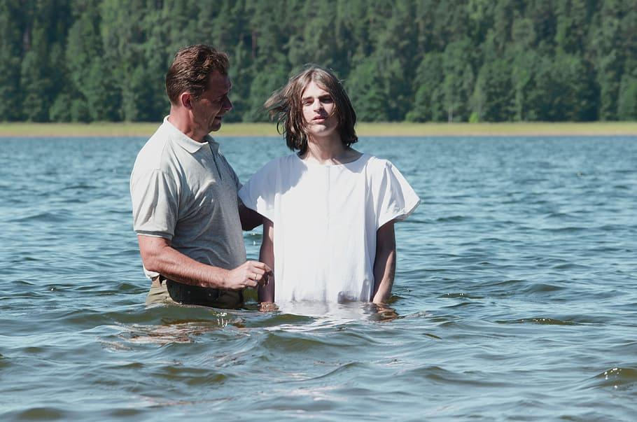
Distinguish Between accepting Christ and baptism
Notes:
Distinguish Between Accepting Christ & Baptism (Slide #29)
What are the differences?
This is the chronology of becoming a Christian.
You become a Christian first when you accept Christ into your life.
We follow through with baptism, as a symbol of what has already taken place in our heart.
It’s interesting…when you ask many adults, “Are you a Christian?”, they will say, “Yes, I’ve been baptized.” These are two different steps. We must become a Christian first, then become baptized. They cannot happen in reverse order.

Slide 30
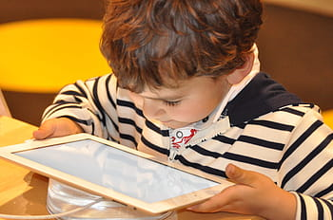
Characteristics of Generation Alpha
Born 2010-Present
Glass Generation
Decline in fine motor skills
Less outdoor play
Deficit in critical thinking skills
Increased anxiety/depression
Prominence of childhood obesity
Notes:
Utilize this portion of the presentation if time permits. This will give an overview of Gen Alpha and the distinctives of their generation.
Characteristics of Generation Alpha (Slide #30)
According to the 2010 Kaiser Family report, children are spending more time connected to their devices than any other activity. This equates to “more than seven and a half hours a day, seven days a week.” (The Big Disconnect)
They are known as the “glass generation” due to the excessive amounts of screentime.
Gen Z is the most anxious generation that has ever lived, primarily due to the repercussions of increased media usage.
We have moved from digital natives (Millennials/Gen Z) to digital addicts (Gen Alpha).
Increased media usage has led to decreased empathy. We are not interacting with each other. (The Big Disconnect, 52).
Children are relational learners. They need interaction. An electronic device is no substitute for human interaction.
For optimal development, children need 4-6 hours of “unstructured” play each day (Mary Ann Bradberry, “Outside…A Whole New World” (lecture, Childhood and Family Ministry Summit, Truett Seminary, Waco, August 13-14, 2021).
Obesity has more than tripled within the last 30 years (The Big Disconnect, 53).
Media is affecting childhood brain development.
According to the Academy of Pediatrics, parents should minimize, if not eliminate technology use for children 2 and below and monitor this time closely for older children (American Academy of Pediatrics, “Media and Young Minds,” Volume 138, Issue 5, November 1, 2016, accessed March 13, 2022, https://publications.aap.org/pediatrics/article/138/5/e20162591/60503/Media-and-Young-Minds)
Studies have shown that the most critical period of development and learning for a child is between the ages of birth through five (The Big Disconnect, 102).

Slide 31
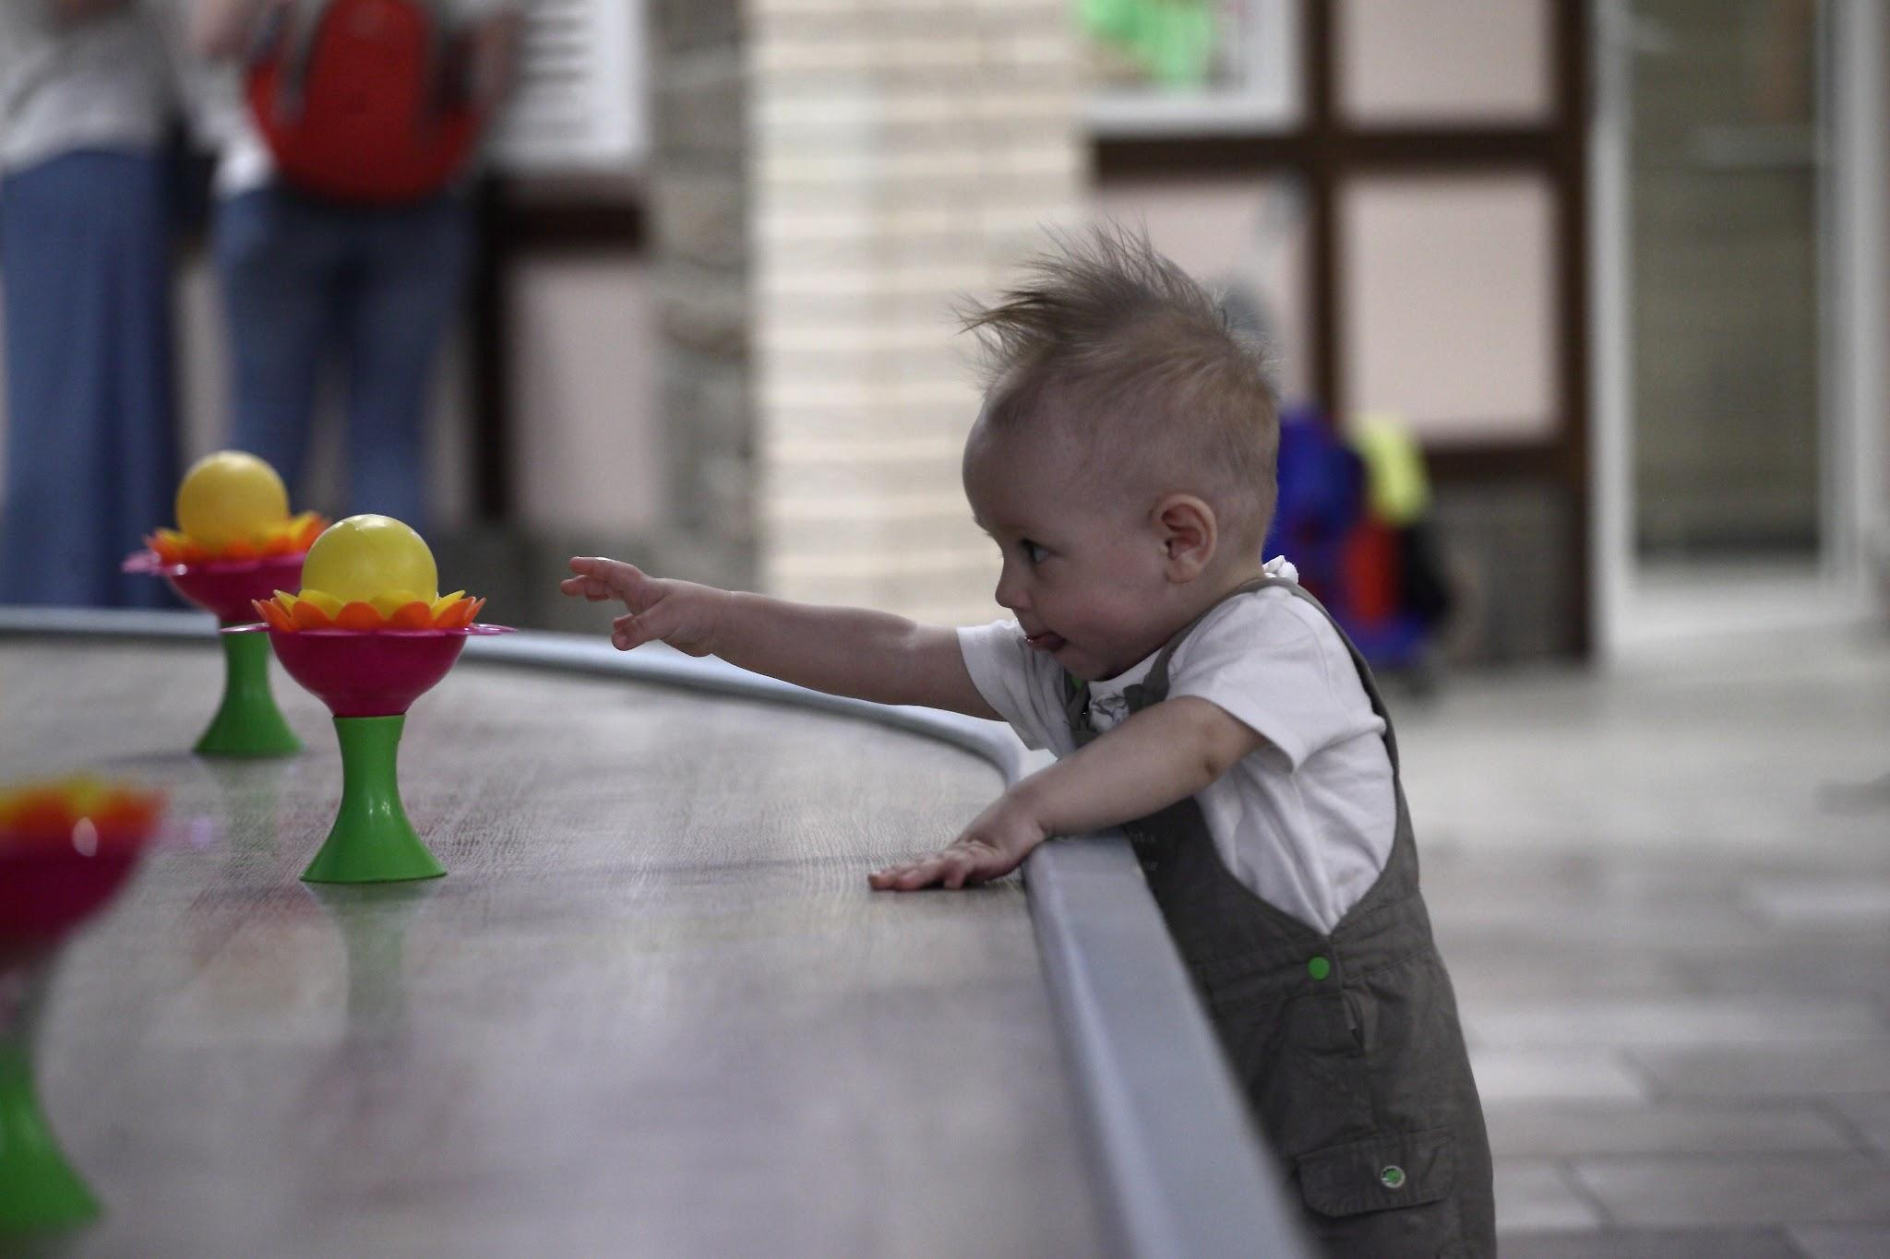
Reaching Gen Alpha
Choose interactive play
“Tell me and I forget. Teach me and I remember. Involve me and I learn.” ~ Benjamin Franklin
Create a safe space
Facilitate wonder and awe
Teach for transformation
Focus on relationships

Slide 32
Partner with Parents
Engage families
Example: simple phone call, video message, text or handwritten note
Minister to parents
Encourage discipleship in the home
Focus on relationships
The teacher who holds my child’s hand,
holds my heart too.

Slide 33

Resources

Slide 34

Available at:
GC2Press.Org
$5/booklet
Available in English & Spanish

Slide 35


I’m a Christian Now!
Class Curriculum
Lifeway.com
$49.99/Kit
$7.49/student book
Available in English & Spanish

Slide 36


www.lifeway.com/agesandstages
Free online resources from Lifeway.com
God’s Plan for Us
Gospel Presentation
https://s7d9.scene7.com/is/content/LifeWayChristianResources/GOSPEL-Gods-Plan-for-Uspdf.pdf
Free Training for Leaders
https://kidsministry.lifeway.com/training
KidsMinistry 101 Magazine
https://kidsministry.lifeway.com/digital-magazine
Newsletter, Blog, Podcast, Videos, etc.
https://kidsministry.lifeway.com
Notes:
Ages and Stages is available in print (for a fee) or downloadable pdf for free.
Kids Ministry 101 is available for free in digital format or print. You must register online. You can also subscribe to Lifeway Kids’ podcast and blog for free.
https://kidsministry.lifeway.com/2016/12/12/free-resources-for-sharing-jesus-with-kids/

Slide 37

Free downloadable resources:
https://www.namb.net/evangelism/for-children

Slide 38
Closing Thoughts

Slide 39
Bibliography
George Barna, “Mental Health and the Church” (breakout session, Hope for the Heart Conference, Plano, TX, June 22, 2024.
Haywood, Janice (2007). Enduring Connections: Creating a Preschool and Children’s Ministry. Danvers, MA: Zondervan Publishing House.
Kids Ministry 101: Practical Answers to Questions About Kids Ministry CD-ROM Item 32, Characteristics of Preschoolers and Children © 2009, LifeWay Press®.
Parr, Steve and Tom Crites (2015). Why They Stay: Helping Parents and Church Leaders Make Investments that Keep Children and Teens Connected to the Church for a Lifetime. Bloomington, IN: WestBow Press.
Wholly Kids: Guiding Kids to Life in Christ (2015). Nashville, TN: Lifeway Press.

