Slide 1

Notes:
NOTE TO LEADER: The suggested times in the notes below add up to around 95 minutes.Try to move through the Mission, Discipleship, and Community sections fairly quickly so more emphasis can be given to the “why” behind the “what,” and to have time to look at the Resources on txb.org/dc toward the end. People will get the idea of how the circles model works by the time you hit the Discipleship circle on slide 6. Emphasize that smaller groups may scale the suggestions back and all groups can modify to fit their situation. But engaging all members in serving some way should become the norm and not the exception. Have fun! Set the example of a joyful leader who looks for God’s best in his people! Thank YOU for serving!
NEW FOR 2025 - While most of these slides are the same as last year, you’ll notice we added slides for the fill in the blanks that are on the handout from last year. You may use the handout from last year OR you can use the new one we created for 2025 OR you don’t have to use either!
LAST THING…We had some issues with fonts and animation so we just made all of the slides JPGS. You may add your name/contact information in the blank space on this opening slide.
If you would rather edit the slides you can use the PP from 2024:
https://cdn.txb.press/txbpress/teams/cch/discipleship/discipleship-collective/2025/Adult-Presentation-Groups-that-Thrive.pptx
(2 min)
Introduce self briefly.
(7 min)
Celebrate what God is doing in our groups/classes!
Groups of 3 -- take 30 sec ea to share one thing God is doing in your group
(Call “time” every 30 seconds to move to next person.)
Let 3-4 ppl share in (15 seconds each) a great thing someone else shared (can’t share your own).
Affirm the leaders for what they are already doing to create a group environment where God can be at work.
State that today OUR GOAL is to leave with some practical tools that may help our groups thrive in making disciples and developing leaders.

Slide 2

Notes:
(10 min) Why Groups? (The next 7 Slides) Also on Handout
Ask: Whatever you call your primary groups ministry, why is it important to your church?
Maybe write some on the white board
SAY: Let me give you 5 reasons why I think Groups are important to your church.
You can fill in the blanks on the handout if you have one.

Slide 3
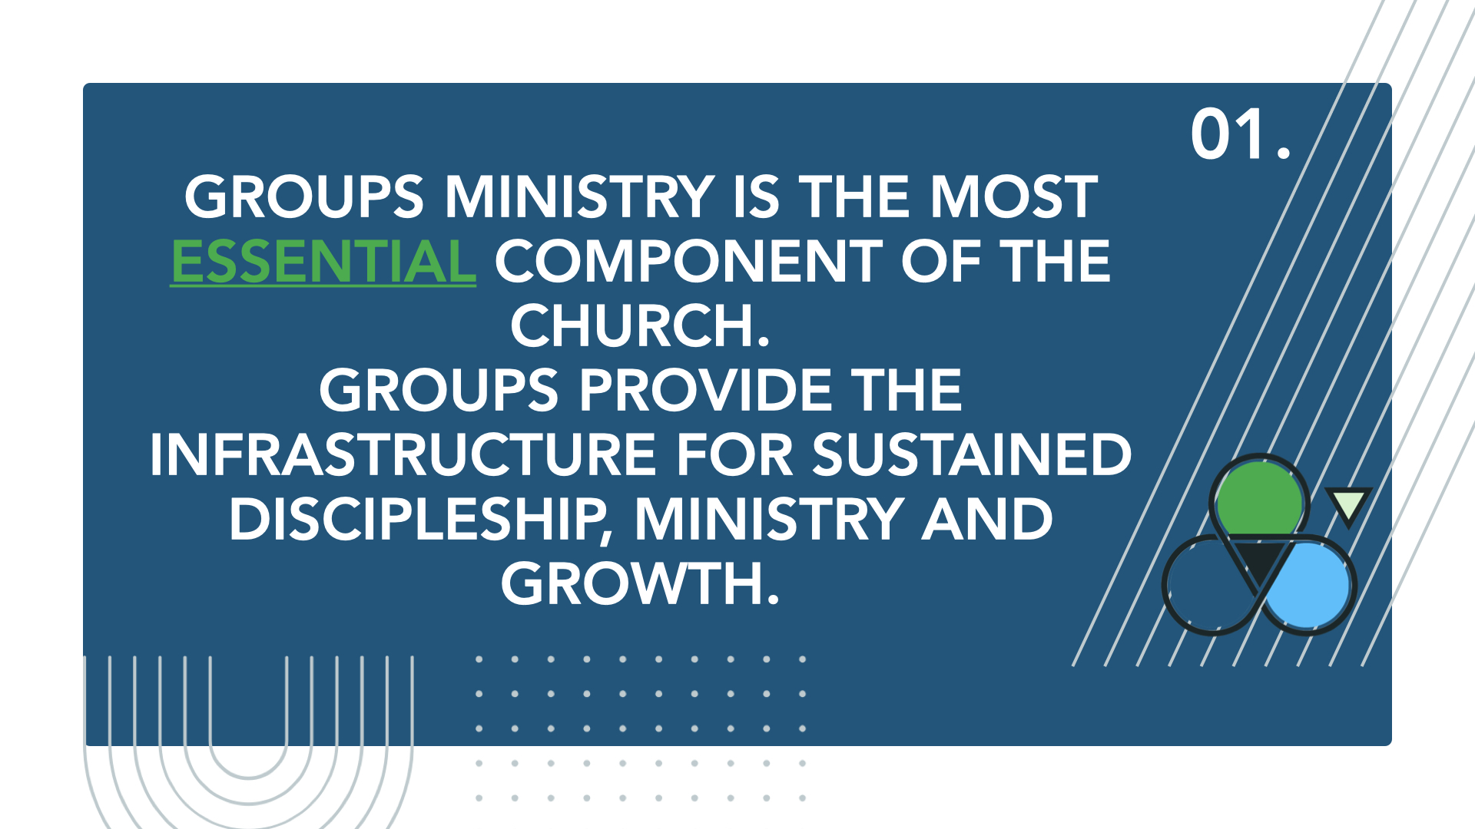
Notes:
Groups ministry is the most essential component of the church. Groups provide the infrastructure for sustained discipleship, ministry and growth.
Jesus’ group of 12 – taught through life lessons and experiences
Jesus said, “…truly I tell you that if two of you on earth agree about anything they ask for, it will be done for them by my Father in heaven. For where two or three gather in my name, there am I with them.” (Mt 18:19–20)
The earliest church met together in the temple courts and broke bread together in their homes. (Acts 2:46)

Slide 4
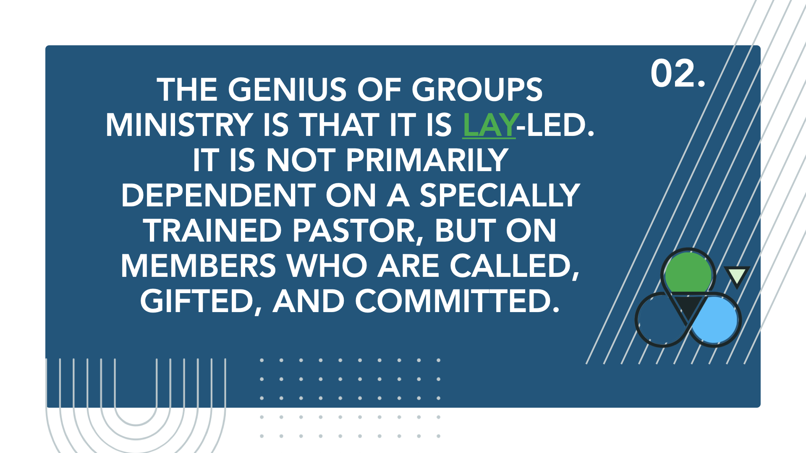
Notes:
Groups ministry is lay-led. It is not primarily dependent on a specially trained pastor, but on members who are called, gifted, and committed. (Continued on next page)

Slide 5
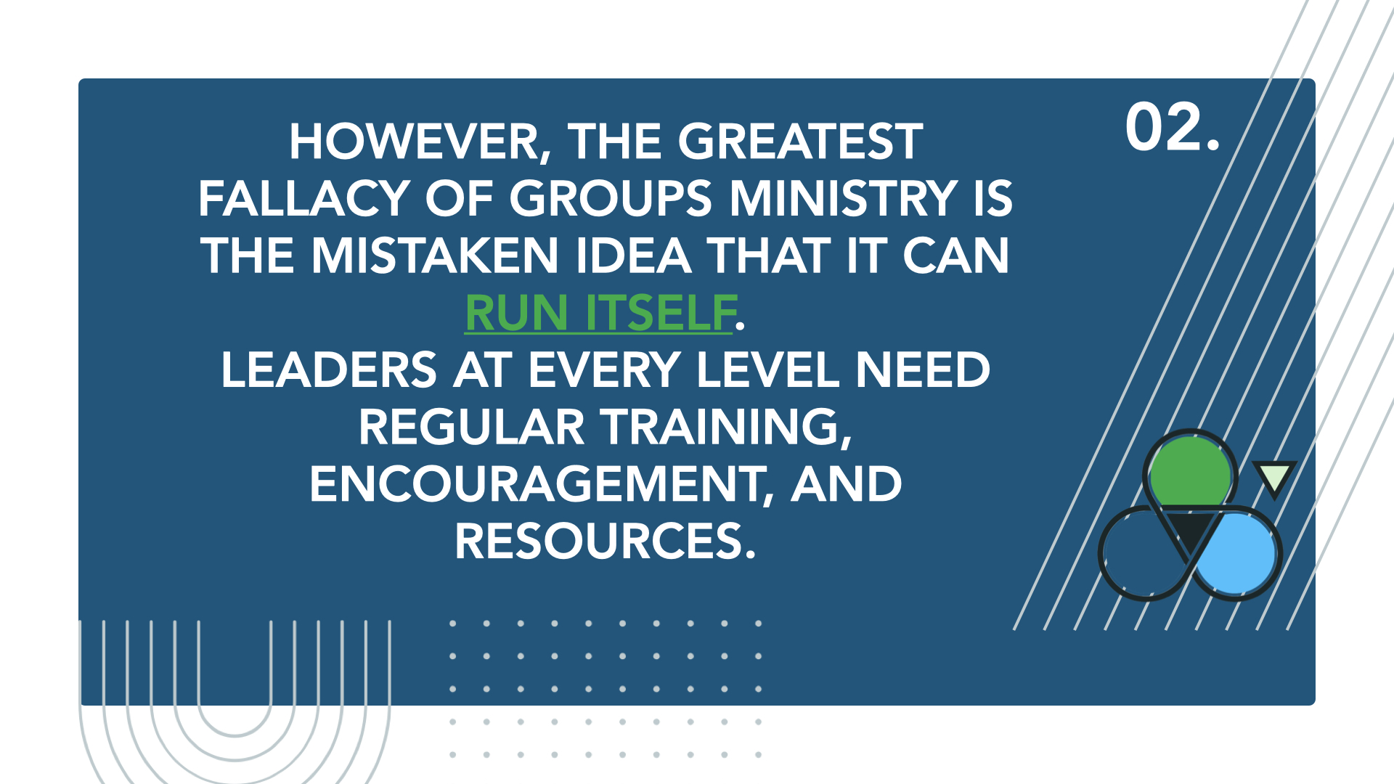
Notes:
However, the greatest fallacy of groups ministry is the mistaken idea that it can run itself. Leaders at every level need regular training, encouragement, and resources.
-That’s why this DC has been organized today - we need to have training times like this on a regular basis

Slide 6
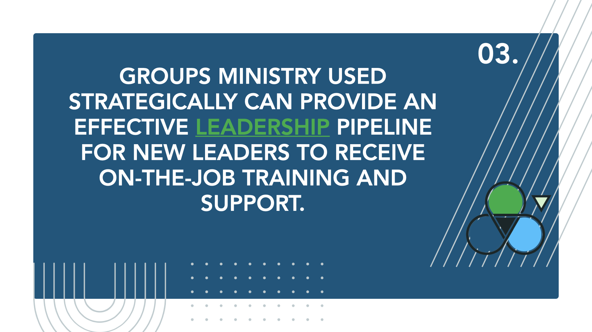
Notes:
Groups ministry used strategically can provide an effective leadership pipeline for new leaders to receive on-the-job training and support.
-Groups that thrive work to involve as many members as possible in kingdom work.
-Members are affirmed in both simple and complex areas of service for the good of the group and the church.

Slide 7
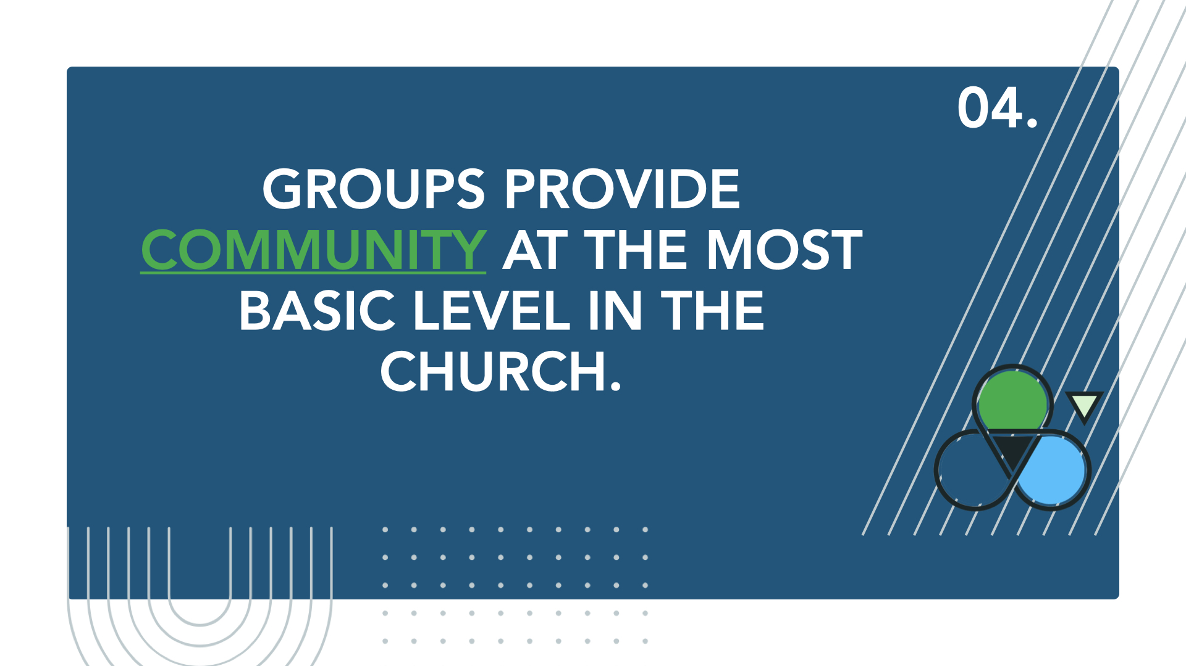
Notes:
Groups provide community at the most basic level in the church.

Slide 8
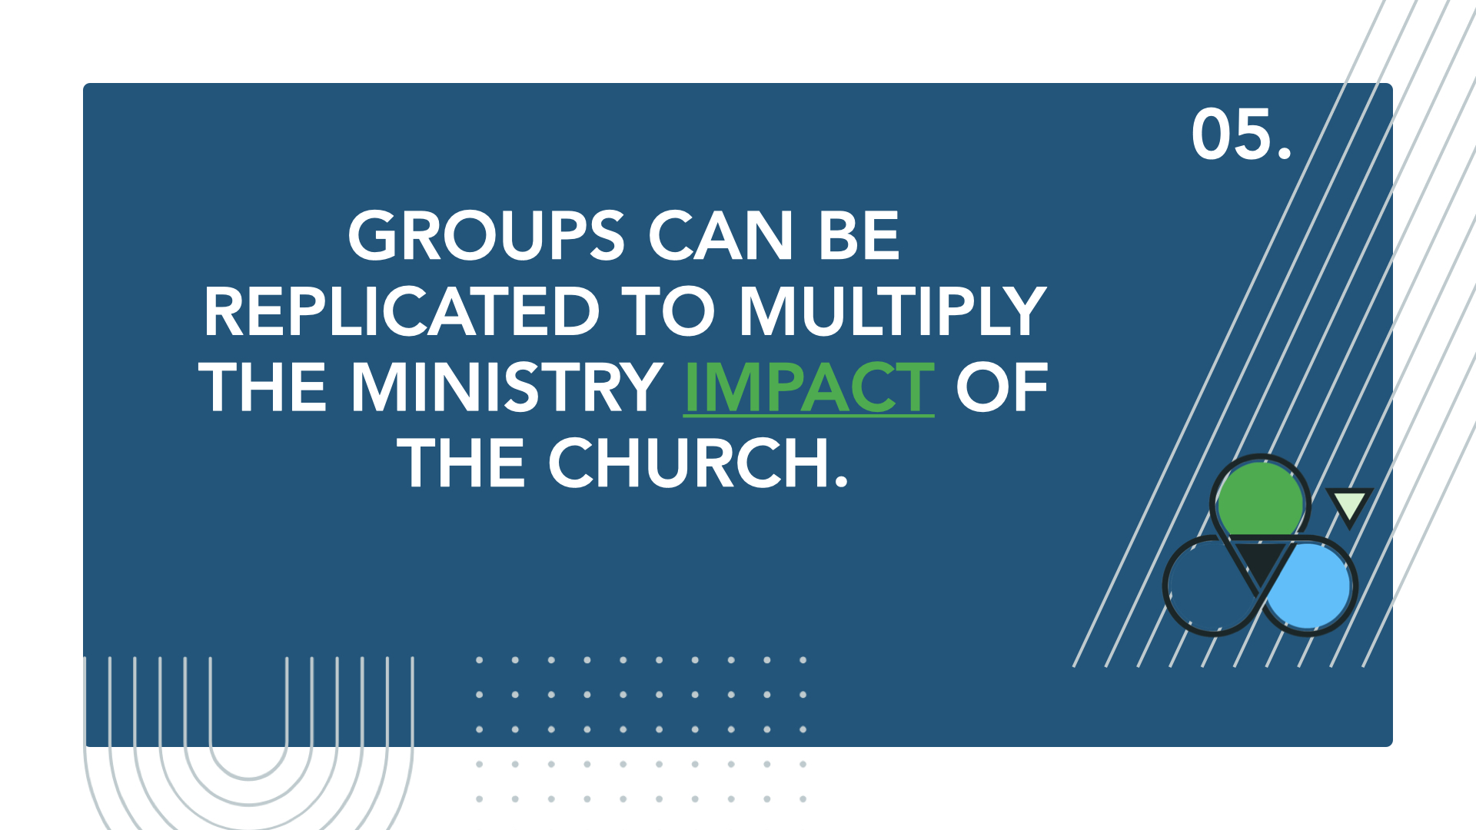
Notes:
Groups can be replicated to multiply the ministry impact of the church.

Slide 9
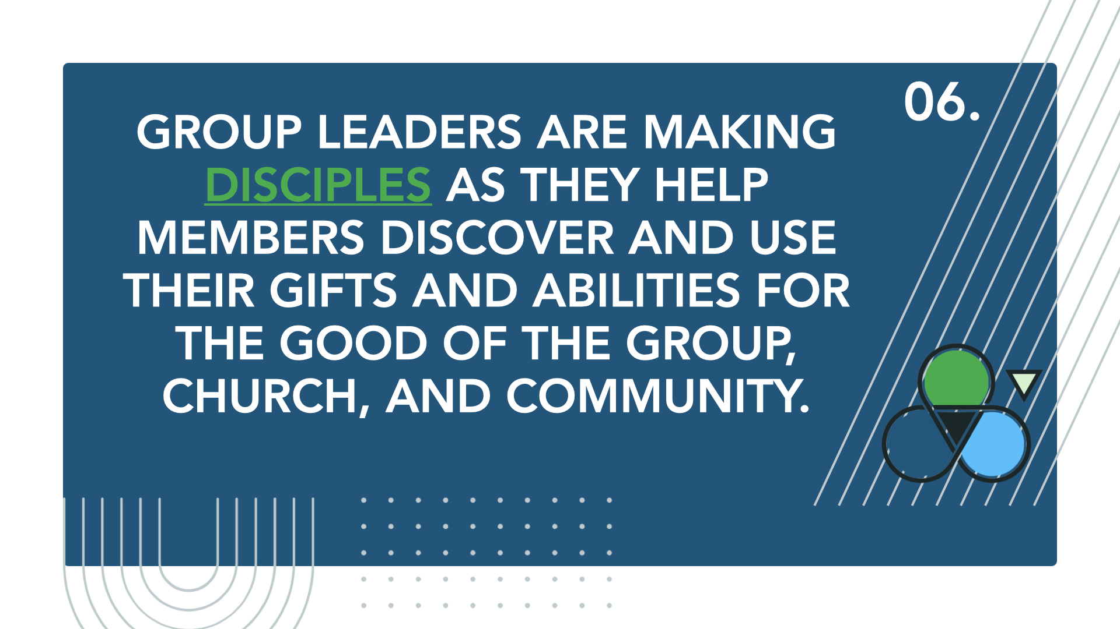
Notes:
Group leaders are making disciples as they help members discover and use their gifts and abilities for the good of the group, church, and community.

Slide 10

Notes:
(10 min)
OPEN v CLOSED GROUPS EXPLAIN
One DEFINITION is important as we begin. Today we will be talking about “open” groups rather than “closed” groups. Here are some distinctives of each:
OPEN
People can come any time
Reaching and assimilating new people is encouraged
No (or little) homework is required
Typically requires less accountability
Often a first-step group in a discipleship strategy
Usually involves a greater %age of church members than closed groups
CLOSED
No new people can join once the group is formed
In-depth Bible study and/or personal development is valued
Prework is often required
Accountability may be greater
Often a 2nd or 3rd step in a church’s discipleship strategy
Usually involves a smaller %age of church members than open groups
Churches need both open and closed groups, but it is important to know the purposes and strengths of each. Today we are focused on open groups, which are typically your church’s primary strategy for discipleship.
Refocus on Today’s Time Together
I hope you will allow your “normal” to be CHALLENGED a little today.
PERMISSION TO NOT BE PERFECT: Sometimes we come to an event like this and feel like we are falling short of what is being suggested. Please don’t have that feeling today. Today is not about perfection, but about making progress.
What I will suggest in this time together will be a lot to soak in, especially if your group is small or struggling. I want to ENCOURAGE YOU to listen for one or two perspectives or tools you can take away today that will help you make disciples and lead your group better.
SAY: What are “Groups That Thrive?”

Slide 11
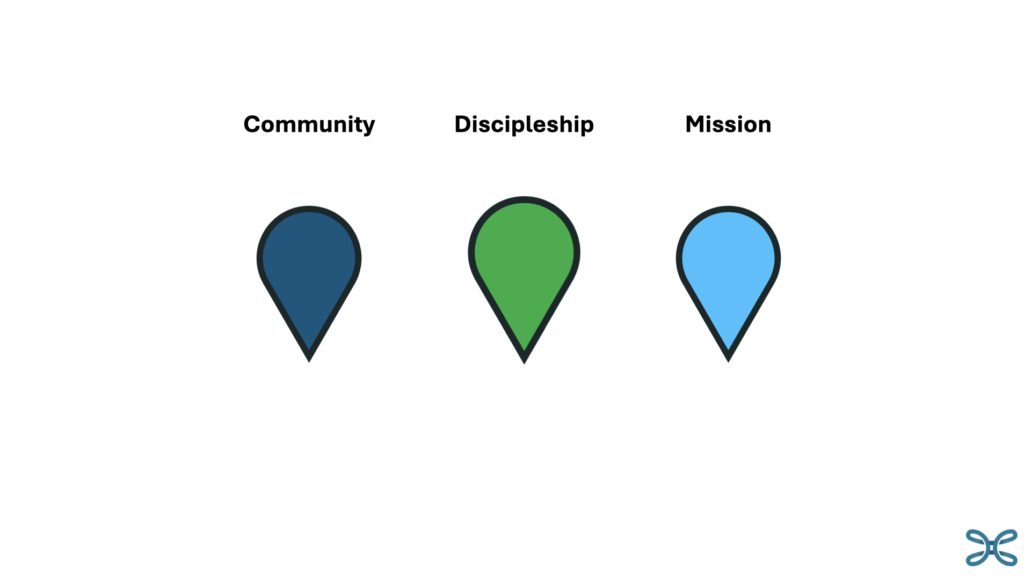
Notes:
WHAT ARE GROUPS THAT THRIVE?
They are groups that experience life and growth in three important areas:
Mission
Community
Discipleship
Today we are going to take a look at each of these areas and see how they come together to form a healthy, thriving small group.
(

Slide 12
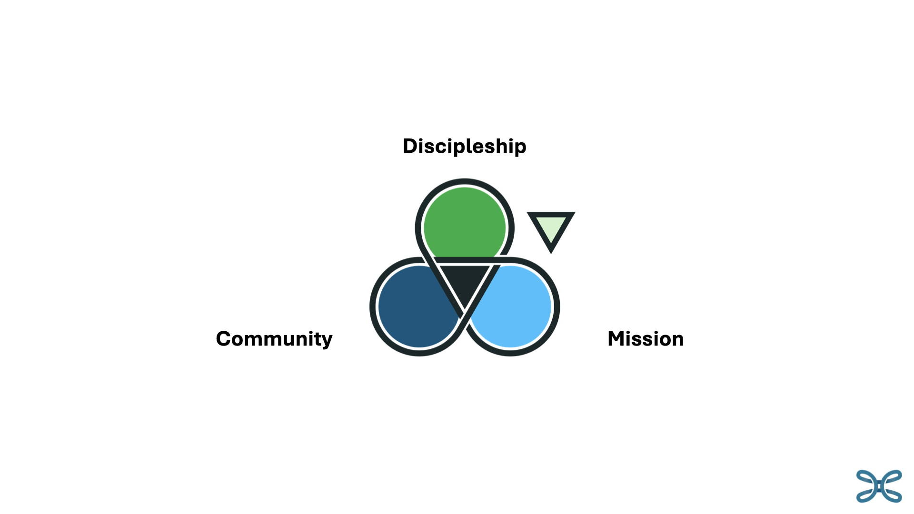
Notes:
(10 min) next 4 slides
The big idea for today is that groups that thrive are those that are moving toward a higher level of involvement and investment by every member, rather than depending on one or two leaders to make community, discipleship, and mission happen.
It is our job as group leaders and teachers to share a vision of what this would look like, then invite our group members to share the load and the joy of serving!
Leaders in Group That Thrive Understand 4 things….

Slide 13
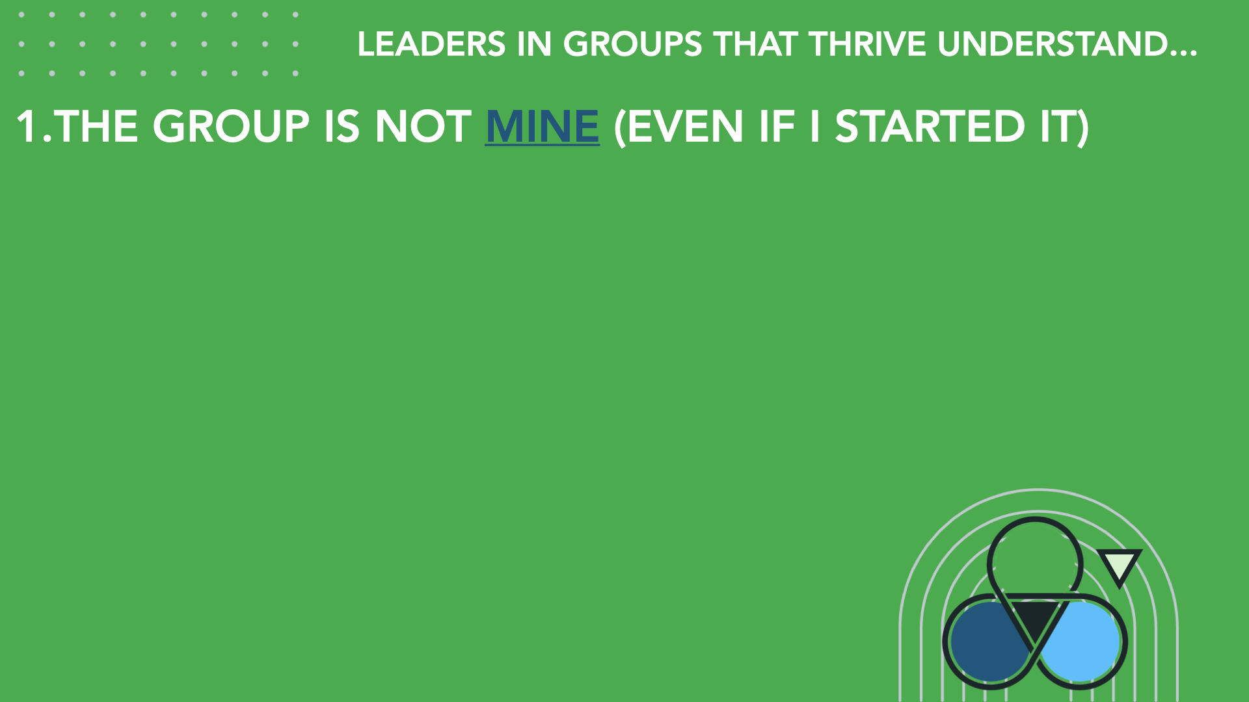
Notes:
The group is not mine (even if I started it).
This must be communicated clearly and consistently to the group
When I do all the work, I get in the way of God’s work of transformation/change in the lives of group members.
The group belongs to all its members, and it will only thrive if everyone contributes in the way God wants them to.
(Yes, ultimately it is God’s group, not mine or theirs!)
He wants to engage them in serving the group, the church, and beyond.

Slide 14
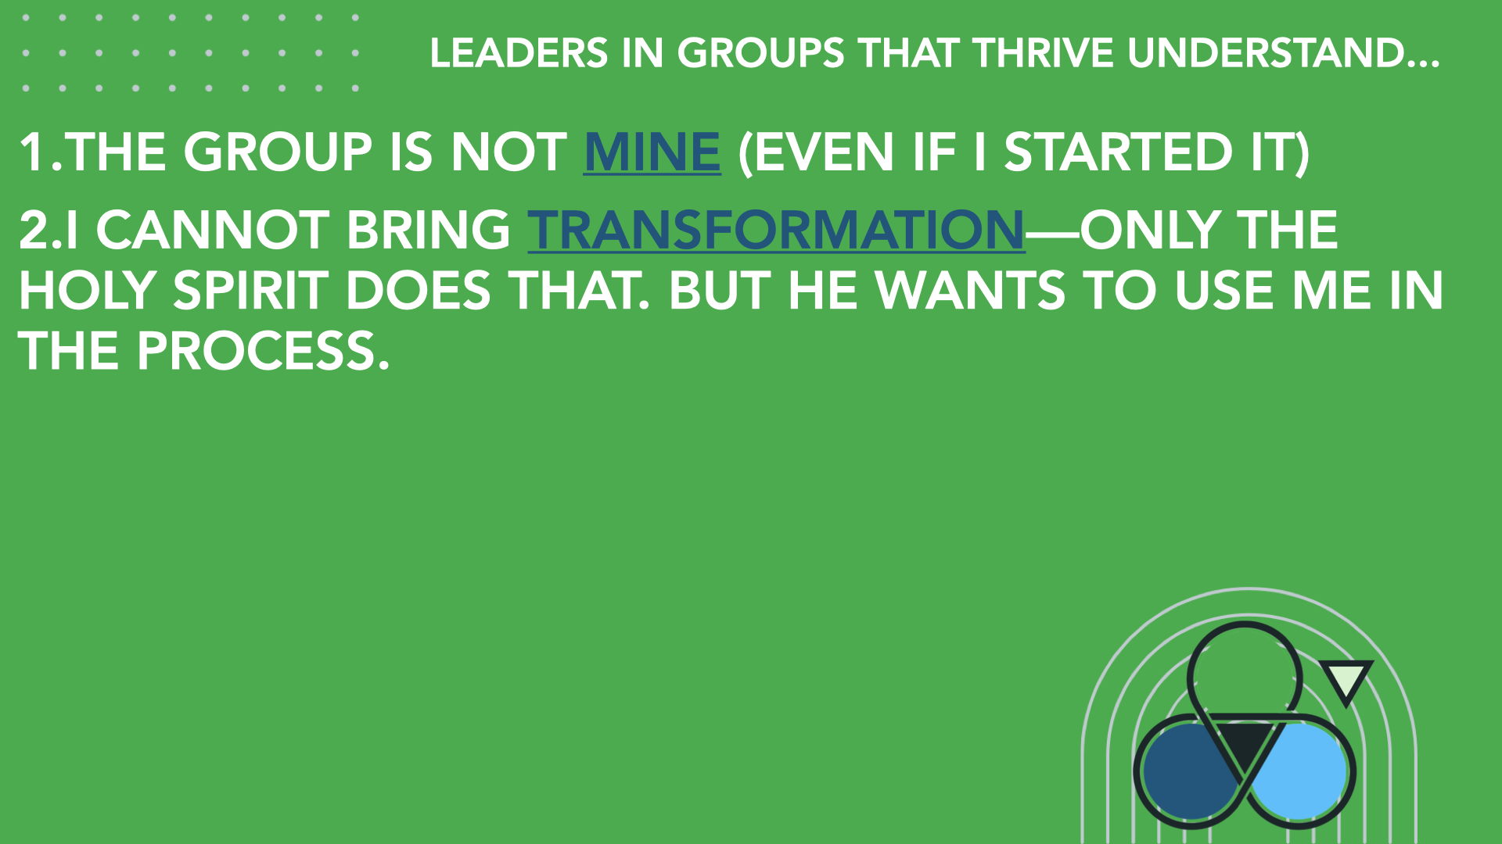
Notes:
I cannot bring transformation—only the Holy Spirit does that. But he wants to use me in the process.
We are called to make disciples of our group members
We are called to disciple them—from where they are now—not where we think they should be
Following Jesus obediently implies action—we must ask them to do, not just be or think or agree
Change is often slow. We must be patient and not give up
There is no insignificant step of discipleship. Affirm every act of service and commitment of group members

Slide 15
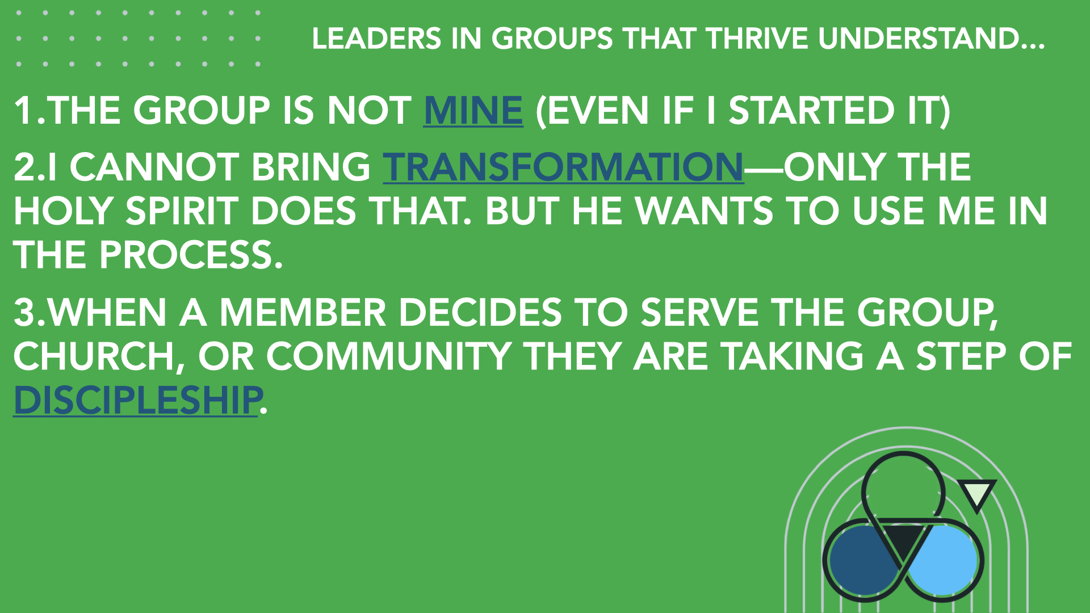
Notes:
When a member decides to serve the group, church, or community they are taking a step of discipleship.
Our job is to help people see our group’s potential in the kingdom and get involved in its work
Every purpose (Mission, Discipleship, Community) requires action and leadership in the group
We are not “organizing” so much as we are “calling out” and “equipping” (Eph. 4:11-16)
People must see how their role in the group connects to God’s larger purposes for our group and church—we must make this clear

Slide 16
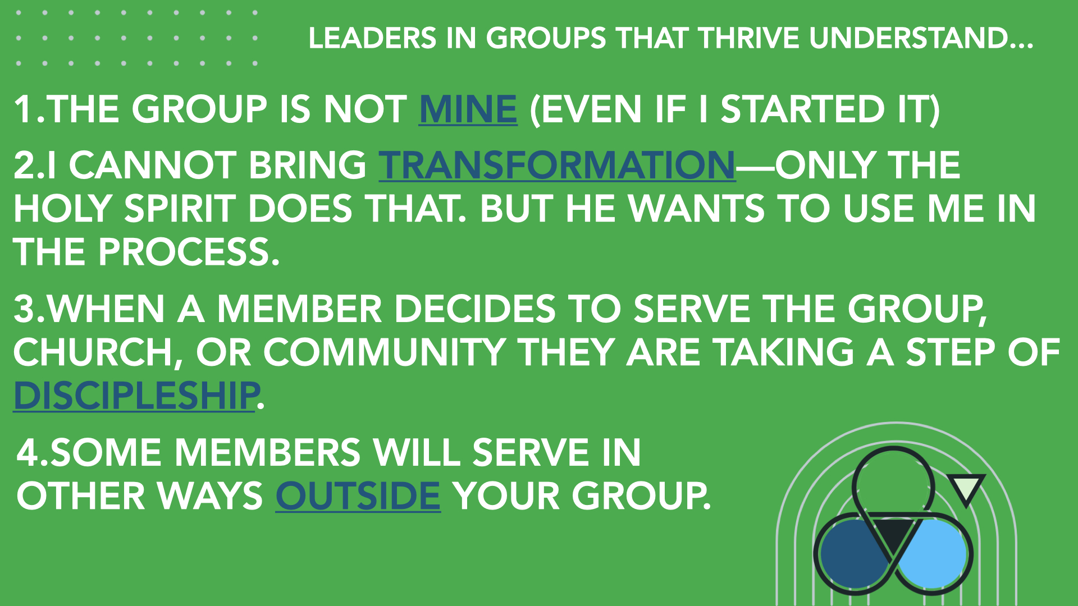
Notes:
Some members will serve in other ways outside your group.
Affirm those who lead in other ministries as if it were a ministry of your group (in a sense it actually is!)
Celebrate when God calls someone out of your group to lead in another group (Yes, it will hurt your average attendance, but in the big picture it is a good thing for your church.)

Slide 17
Notes:
(Pass out Adult Group Ministry Circles Model handout.)
To help us visualize a thriving group, we will work through a simple tool using this graphic that you can use to encourage every member to be involved in Mission, Community, or Discipleship. The goal would be to have every member’s name in one of these three areas, representing their commitment to help the group thrive.
There is an editable Microsoft Word version you can download on our website www.txb.org/dc

Slide 18
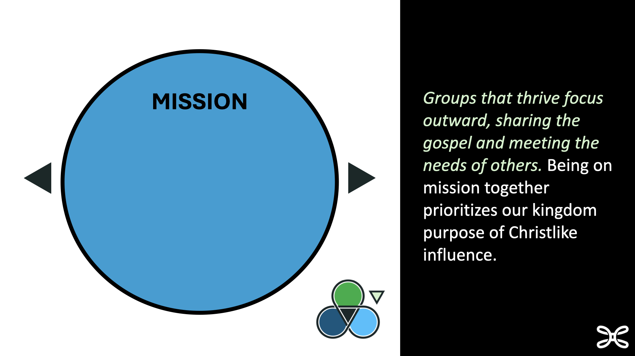

Notes:
MISSION
(5 min this slide)
Thriving groups have an outward-focused component – they are on mission together beyond the walls of their church and home. We are called to influence our world by being like Christ.
A young man read a current book about Sunday School and was surprised to find that SS had a missional element. He had never heard that before. His perception and personal experience of Sunday School was just a Bible study without any thought that the group should have an outward focus. This is ironic, because the Sunday School movement began over 230 years ago to make a difference for uneducated and unchurched children in Gloucester, England, who worked in factories six days a week and had only Sunday off. That first Sunday School used the Bible to teach reading and was the first introduction to the gospel that many of those children ever had.
Being on Mission together may be the missing “secret sauce” for many groups that struggle to thrive.
On a scale of one to ten, how would you say your group is doing with a missional focus?
Let’s talk about how we might engage group members to be on Mission together.

Slide 19
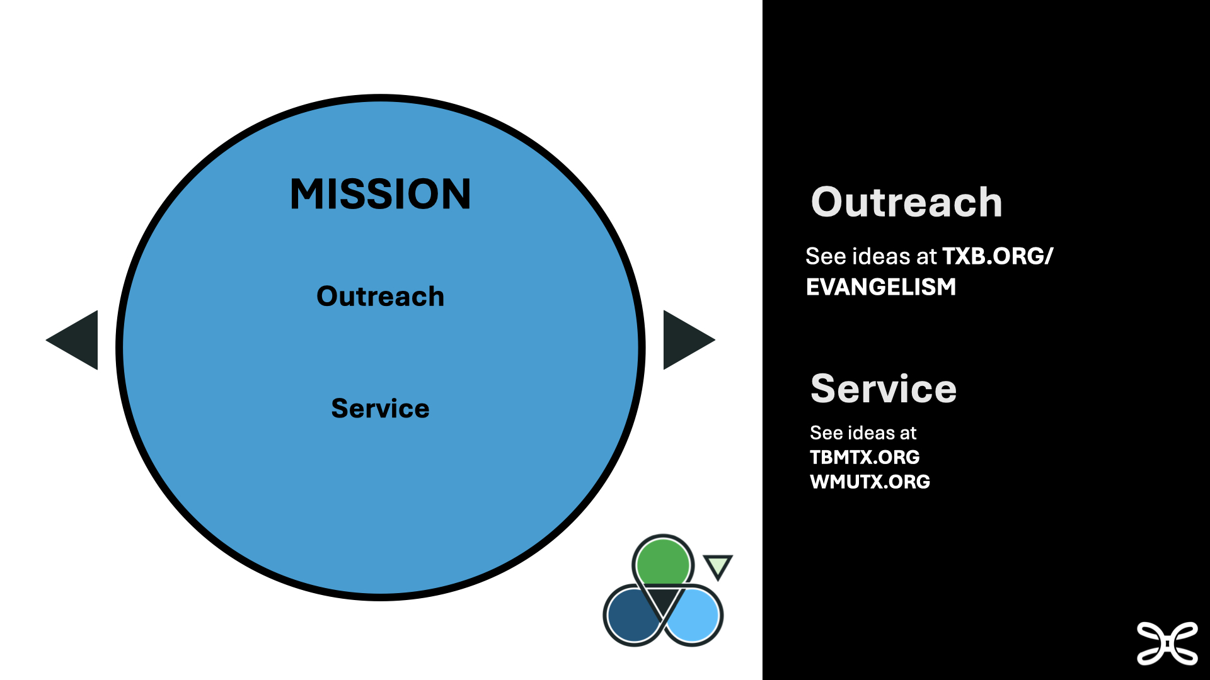
Notes:
(10 min this slide)
What kinds of actions or activities might indicate a group is on Mission together?
(list on board)
Next, who in your group would be most passionate or interested in the group being on Mission together? (If you can’t think of anyone, begin to ask God to put this on someone’s heart and ask your group to join you in this prayer. Be persistent in prayer AND in asking your group to pray. It often takes time.)
Depending on the person and the group, this person might be your Outreach leader or Service leader. Or your class/group may just need one “MISSION” leader. To illustrate, let’s assume you will have two leaders in the Mission circle of our graphic—one who loves Outreach and one who loves Service. You might have other roles in your group.
How will you help them get started leading the group in these areas?
Explain the job.
Empower them.
Regularly give them some group time to engage the rest of the group.
Outreach Leader
READ “WHAT DO I DO?” on handout. Discuss value of having at least a brief job description for each leader.
Multiple people can lead here, but select one to be THE leader (same idea throughout)
What are some things an outreach leader could lead the class to do?
Point out txb.org/evangelism as a source of witnessing tools
Easter egg hunt for kids (ask guests if they’ve heard the Easter story)
Teach group the 3 Circles gospel presentation
Nametags (open groups should actually expect and invite guests!)
Guest follow up – HOW?
Who will be responsible for calling/texting/emailing?
Invite to lunch
Invite to sit in worship
Invite to fellowships
Ask if want to be on FB page, group messaging, etc.
See link to “General Evangelism Strategies” at txb.org/evangelism
4XFour Challenge
Storytelling
One-verse Evangelism (Rom 6:23 – wages sin death gift life)
Service Leader
READ “WHAT DO I DO?” on handout. Emphasize that your “job descriptions” can be customized but should not overwhelm group members. (They can also be fun.)
Multiple people can lead here – PUT NAMES ON VISUAL
What can a service leader help the group to do?
Homeless hygiene kits
Assisting senior adults in community
Food bags for school kids
Adopt a Baptist Student Ministry student from a local college (see Brenda Sanders with TXBSM)
tbmxtx.org and wmutx.org for ideas (Your group also has other unique opportunities)
Ask, “What have you seen in your church to get a group involved in Mission?

Slide 20
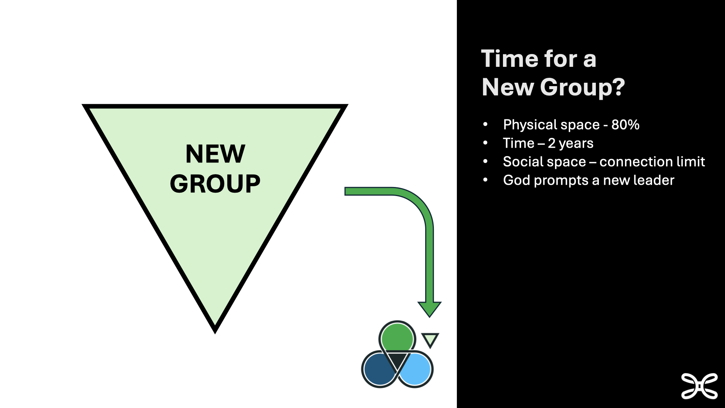
Notes:
(NOTE TO LEADER: While new groups can be a healthy growth strategy in just about any community, the focus of this seminar is encouraging leaders to get maximum member involvement in ministry to and through their groups. Starting new groups can be an emotional idea for some leaders. Do not get distracted by a debate around starting new groups.)
(5 min this slide)
Next New Group
The light green triangle in the model represents the idea of your group helping start a new group.
If we want to reach our communities for Jesus, we must develop a culture that says new groups are essential. I totally understand resistance to this idea.
Some of you have been hurt,
Others were made uncomfortable, and
Still others believe your success as a group is measured by how many are in it.
LET ME TRY TO PAINT A DIFFERENT VISION FOR NEW GROUPS.
(Share a story of difficulty of newcomer finding a group or story of a new group reaching new people)
Say, “Here are some ways we know it may be time to start a new group:” (click for each way)
Physical space
80% of space capacity is full
SUGGESTED SQ FT PER ADULT HAS BEEN 15 (prob higher post-covid)
SUGGESTED ENROLLMENT MAX 35 (typical 50% att = 17.5) WHY?
Time (2 years)
Group culture is set - hard for new people to break into
We have our own stories, communication patterns, group history
Social space
People are like Legos-we all have limited connections avail
There’s a BIG difference in being friendly and being a friend
God is prompting someone(s)
If only man is prompting, it may not be time
If God is prompting, we’d better be open and obedient
RELATED RESOURCE AT txb.org/dc
Checklist for Starting New Groups

Slide 21
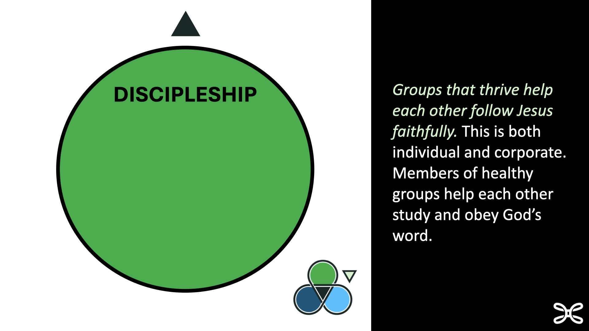
Notes:
DISCIPLESHIP
(5 min this slide)
Thriving groups involve multiple members and multiple formats to help people grow in their walk with Christ.
How would you define discipleship? (allow brief answers, include your own or these ideas from 2 Timothy)
Using my gifts and abilities for the cause of Christ (2 Tim 1:6)
Living faithfully regardless of circumstances (2 Tim 2:1)
Helping another believer grow in thinking and acting like Jesus (2 Tim 2:2)
Becoming a self-feeder who “correctly handles the word of truth.” (2 Tim 2:15)
Our groups must become much more than just hearing a good teacher or enjoying each others’ company. Our groups are fertile soil for people to grow beyond where they are today in thinking and acting like Christ.
On a scale of one to ten, how would you say your group is doing with helping people grow in thinking and acting like Jesus?
Let’s talk about how we might engage group members in life-changing Discipleship together.

Slide 22
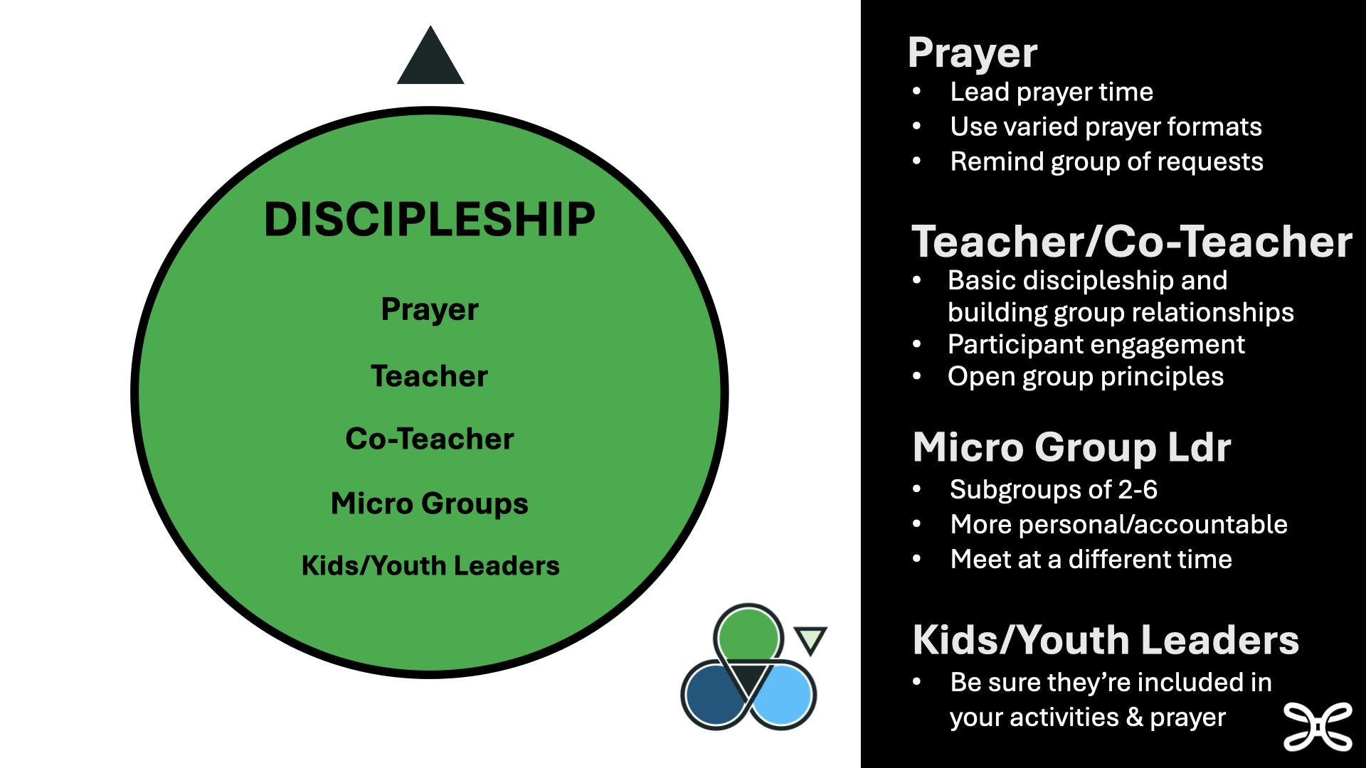
Notes:
(10 min this slide)
What kinds of actions or activities might indicate a group is growing in DISCIPLESHIP? (list on board)
Next, who in your group would be most passionate or interested in helping disciple others? (If you can’t think of anyone, begin to ask God to put this on someone’s heart and ask your group to join you in this prayer. Be persistent in prayer AND in asking your group to pray. It often takes time.)
Depending on the person and the group, this person might be one of the leaders listed in the circle. Or your class/group may just need a PRAYER leader and a TEACHER right now. But let me stretch your thinking by suggesting you at least need a CO-TEACHER. We should always be developing new people to guide group Bible study.
How will you help them get started leading the group in these areas?
Explain the job.
Empower them.
Regularly give them some group time to engage the rest of the group.
READ ROLE DESCRIPTIONS UNDER DISCIPLESHIP on handout for leaders listed. Discuss value of having at least a brief job description for each leader. (The part about sports teams is just for fun, and the job description for KIDS TEACHER should be provided by the kids ministry leader, not us.)
How could I help a PRAYER leader lead the group well? (click) for starter ideas, then brainstorm others.
How could I help a TEACHER or CO-TEACHER lead the group well? (click) for starter ideas, then brainstorm others.
What is a MICRO GROUP and how could I help someone start a group like this? (click) for starter ideas, then brainstorm others.
How could I encourage group members to serve as a KIDS TEACHER? (click) for starter ideas, then brainstorm others.
Ask, “How have you seen someone grow as a follower of Jesus by stepping up to help others grow in some way?”

Slide 23
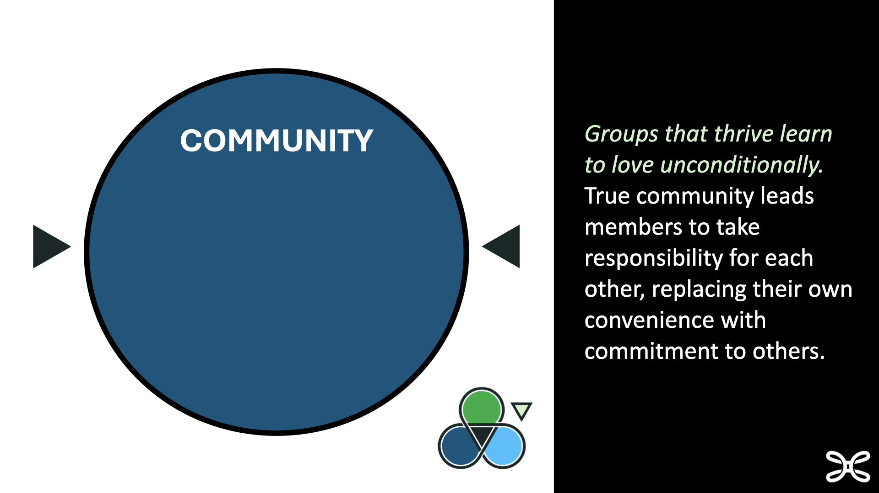
Notes:
(5 min this slide)
Thriving groups share the joys and responsibilities of being together and caring for each other.
What is biblical community? (allow brief answers, include your own or these ideas)
Acts 2
Community is often fun, but it can also be hard.
On a scale of one to ten, how would you say your group is doing with Community?
Let’s talk about how we might engage group members in meaningful Community.

Slide 24
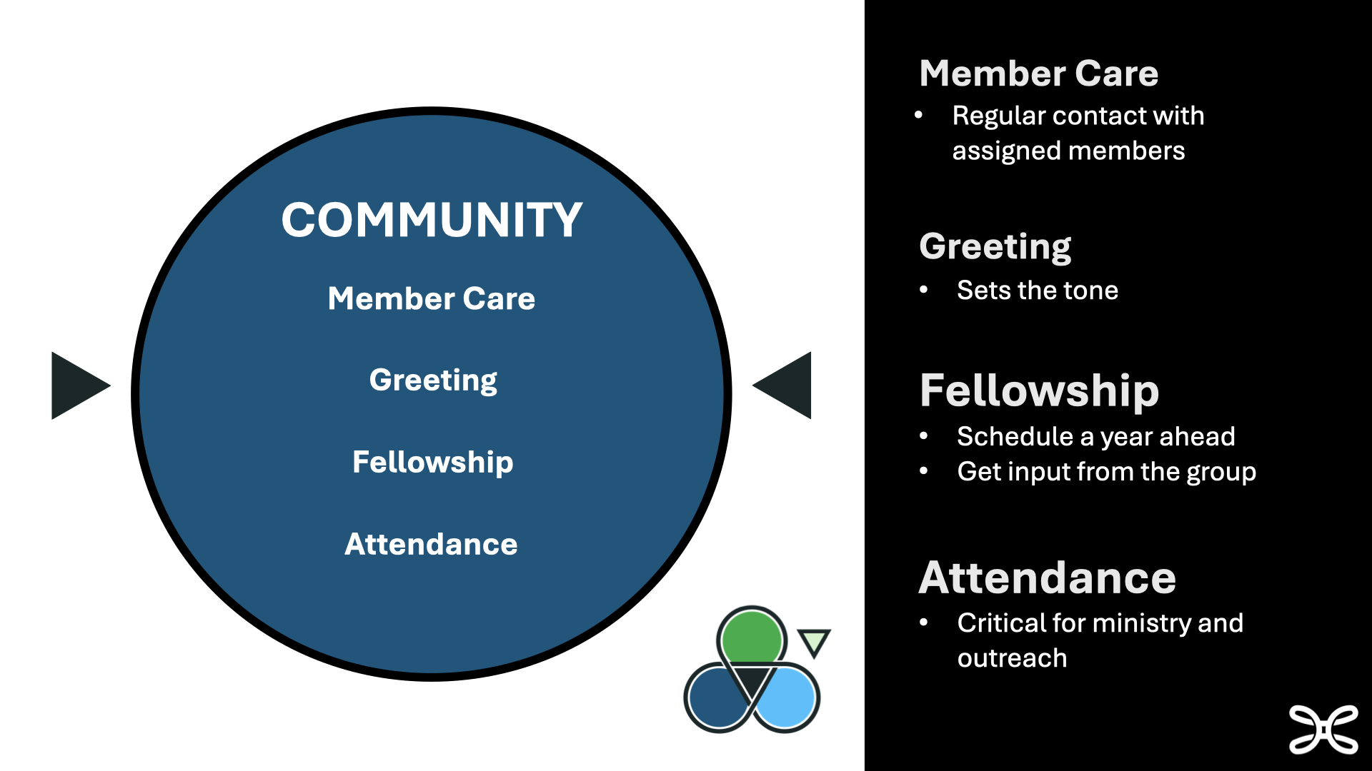
Notes:
(10 min this slide)
How could you tell if a group is experiencing biblical COMMUNITY? (list on board)
Next, who in your group would be most passionate or interested in helping facilitate Community? (If you can’t think of anyone, begin to ask God to put this on someone’s heart and ask your group to join you in this prayer. Be persistent in prayer AND in asking your group to pray. It often takes time.)
Depending on the person and the group, this person might be one of the leaders listed in the circle. Or your class/group may just need one person who will work to develop Community within the group. You can add other roles as you add new people to your group.
How will you help them get started leading the group in these areas?
Explain the job.
Empower them.
Regularly give them some group time to engage the rest of the group.
READ ROLE DESCRIPTIONS UNDER COMMUNITY on handout for leaders listed.
Discuss value of having at least a brief job description for each leader.
Member Care Leader – Remember “care groups”? The idea can still work when people realize that people can fall through the cracks if we are not very intentional. Very small groups may only need one person, but be sure to share the load as your group gets beyond 5 or 6 members (not just attenders).
Greeting – You probably already have someone who does this naturally. Help them see why it is important to the kingdom of God and the health of your group.
Fellowship – Some call this the “party person” or team. Multiple people can certainly be involved here.
Attendance – Periodically explain why this role is important to caring well for each other and following up with guests. The spiritual implications of this job are great.
Coffee and Donut Connoisseur – This one’s not on the list, but you can create your own roles if they give someone a place to serve!
WHAT HAVE YOU SEEN WORK IN YOUR CHURCH?

Slide 25
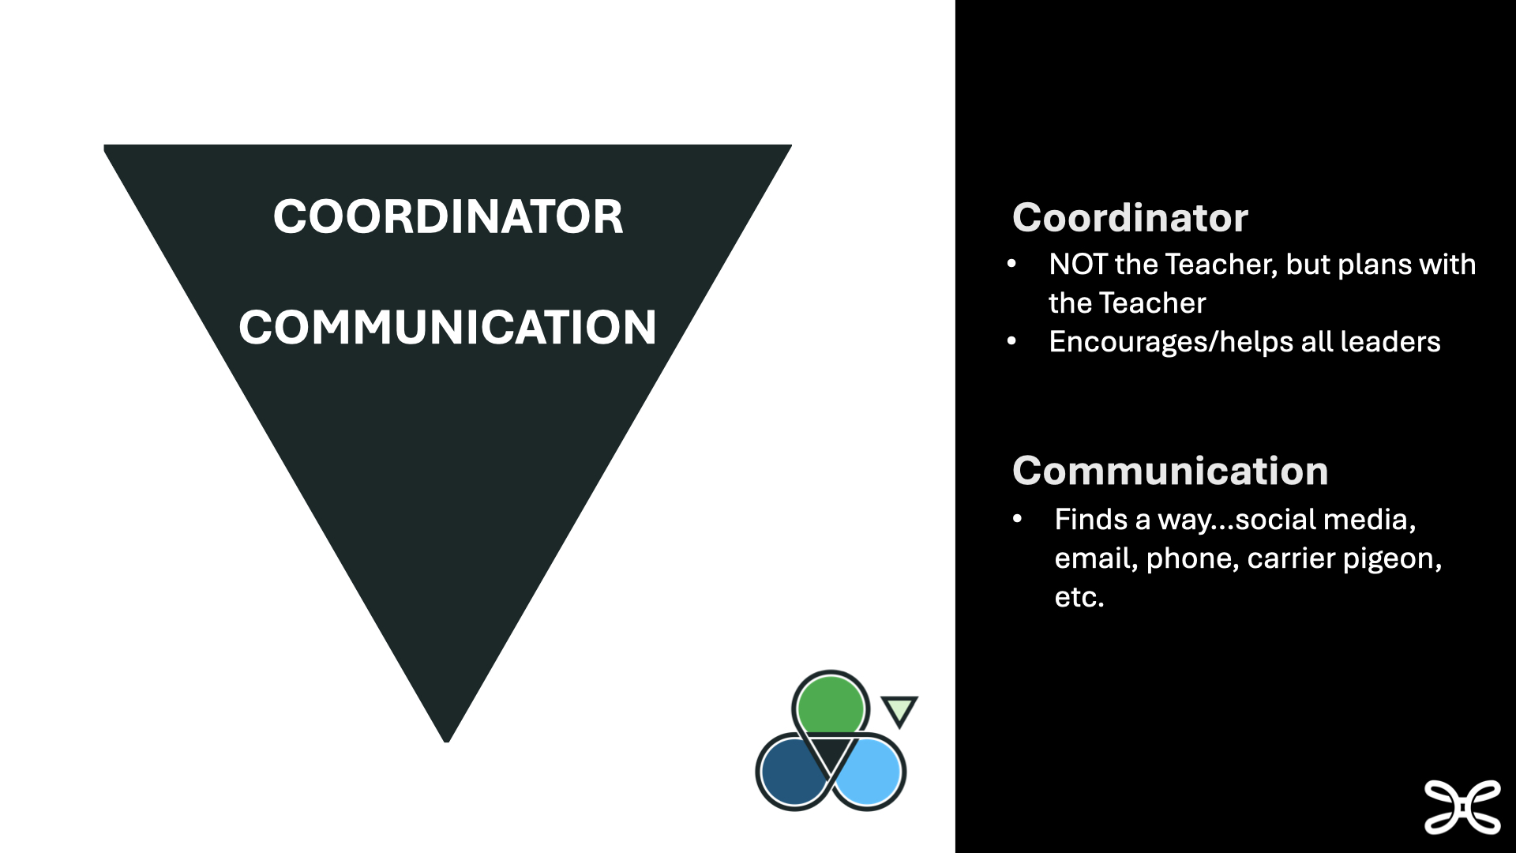
Notes:
(3 min this slide)
A key person is shown in the middle of our three circles model…
Group Coordinator
Keeps all leaders encouraged and motivated.
Should NOT be the teacher. The whole idea is that groups thrive when everyone is invested. When everything runs through the teacher fewer people will step up. In fact, when any one person holds on to a group too tightly, it can give the impression that others are not needed for the group to be “successful.” Our suggestion is that a teacher becomes a cheerleader for all things besides leading Bible study. AND is willing to give up TIME so others can take the lead.
Should plan ahead with the teacher and other leaders in the group. Having something to look forward to is important for group health.
Ask, “Who might be a good COORDINATOR for your group?”
Suggest that an extended time of prayer precede asking this person to serve. The wrong person in this role can bring frustration, but the right person can launch the group toward thriving!
In addition, larger groups may need a…
Communication Leader
Insures everyone gets the latest news and information concerning the group.
Consistent communication helps all group members and guests feel included.

Slide 26
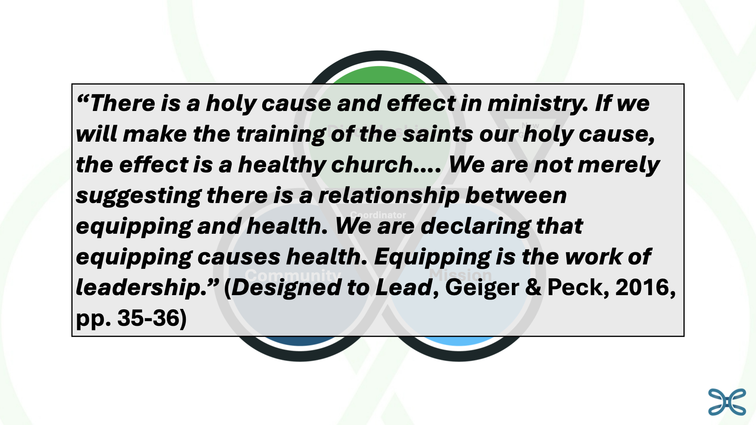
Notes:
(3 min this slide)
What results can we expect if we begin to engage our group members in leading Mission, Community, and Discipleship in our groups?
(click for quote)
“There is a holy cause and effect in ministry. If we will make the training of the saints our holy cause, the effect is a healthy church…. We are not merely suggesting there is a relationship between equipping and health. We are declaring that equipping causes health. Equipping is the work of leadership.” (Designed to Lead, Geiger & Peck, 2016, pp. 35-36)
Our groups will become healthier, our churches will become healthier, and our group members will grow as followers of Jesus when we invite them to take a step of discipleship and serve. The good news is WE get to be a part of helping them experience this growth.

Slide 27

Notes:
(10 min)
Spend a few minutes on the Discipleship Collective web page showing available resources. The link on the PPT slide should be clickable, but you’ll need to be connected to wifi.
Invite them to find the page on their phones.
Click on a few links of interest to your group
Point out last year’s training models they can use in their own churches
Ask for other suggested resources

Slide 28
Notes:
(3 min) What is one thing you will put into practice because of our time together today?
(2 min) Pray for the leaders and dismiss.

